Slide 1
Future Research

Slide 2
POTENTIAL RESEARCH IDEAS
More effective shift mapping
Notes:
Infinite way to do shift mapping.
ME -> Best but costly
Balance between efficiency difficult.

Slide 3
POTENTIAL RESEARCH IDEAS
More effective shift mapping
Better reconstruction
“Deep Convolutional Reconstruction For Gradient-domain rendering”
Kettunen et al., SIGGRAPH 2019

Slide 4
POTENTIAL RESEARCH IDEAS
More effective shift mapping
Better reconstruction
Higher order derivatives (Wavelet, Laplacian)

Slide 5
POTENTIAL RESEARCH IDEAS
More effective shift mapping
Better reconstruction
Higher order derivatives (Wavelet, Laplacian)
Heterogenous participating media

Slide 6
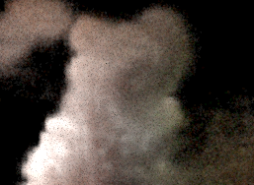
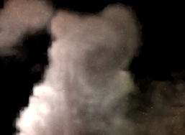
POTENTIAL RESEARCH IDEAS
More effective shift mapping
Better reconstruction
Higher order derivatives (wavelet, Laplacian)
Heterogenous participating media
Beam Radiance Estimate
Gradient-domain
Beam Radiance Estimate
Ray marching for transmittance evaluation

Slide 7
POTENTIAL RESEARCH IDEAS
More effective shift mapping
Better reconstruction
Higher order derivatives (Wavelet, Laplacian)
Heterogenous participating media

Slide 8
POTENTIAL RESEARCH IDEAS
More effective shift mapping
Better reconstruction
Higher order derivatives (Wavelet, Laplacian)
Heterogenous participating media
Path guiding for gradient computation

Slide 9
SUMMARY

Slide 10
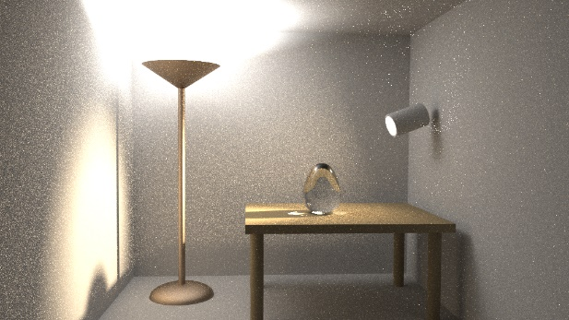


SUMMARY
$$I_{j}$$
$$\overline{x}$$
Primal

Slide 11
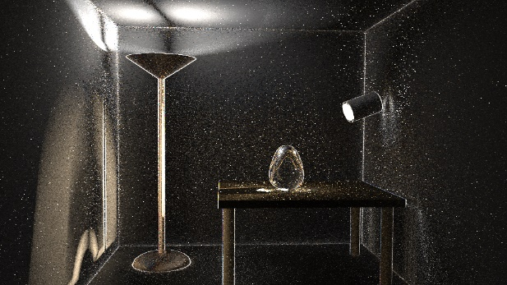


SUMMARY
$$I_{j}$$
$$\overline{x}$$
Primal
-
$$T(\overline{x})$$
$$G_{ij}$$
Gradients

Slide 12
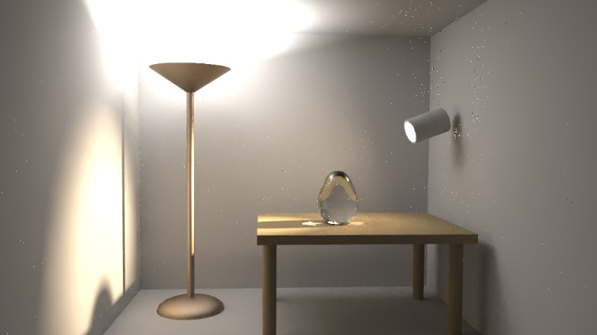
SUMMARY
$$I_{j}$$
$$\overline{x}$$
Primal
Reconstruction
-
$$T(\overline{x})$$
$$G_{ij}$$
Gradients

Slide 13
SUMMARY
$$I_{j}$$
$$\overline{x}$$
Primal
Reconstruction
-
$$T(\overline{x})$$
$$G_{ij}$$
Gradients
+ Extensions (Advanced topics)

Slide 14

Open-source implementation
Mitsuba implementation [Jakob 2010]
https://github.com/gradientpm/gradient-mts
Integrators
(Volume)
Integrators
Reconstruction
Extra
(G-)PT
(G-)BDPT
(G-)PM
(G-)VCM
Path Reuse
BCD
NFOR
(G-)VPM
(G-)BRE
(G-)Beam
L1 & L2
Uniform
Weighted*
*only for G-PT

Slide 15
Acknowledgement
We are grateful to all authors of gradient-domain rendering for making their source code available.
We also thank the following authors for the permission to include materials from their publications into the STAR:
Jaakko Lehtinen, Aalto University and NVIDIA
Bochang Moon, Gwangju Institute of Science and Technology

Slide 16
Acknowledgement
We also thank the following researchers:
Wenzel Jakob for the Mitsuba renderer.
Fabrice Rousselle for some presentation slides of image denoisers we derived.
Nicolas Vibert for helping with some early experiments.
Jamorn Sriwasansak for proofreading the paper.

Slide 17
Acknowledgement
We thank the following researchers and artists for making the beautiful scenes:
Eric Veach, Leo Guibas, Miika Aittala, Samuli Laine, and Jaakko Lehtinen (the Door scene)
JayArtist (Kitchen)
Wig42 (Staircase)
Mareck (Bathroom)
Chaos Group and Jaroslav Krivanek (Spotlight bathroom)
Marko Dabrovic (Sponza)
Tiziano Portenier (Bookshelf, Bottle, and Bathroom)
MrChimp2313 (House)

Slide 18
ACKNOWLEDGEMENT
This project was partly funded by
JSPS KAKENHI grant numbers 15H05308 and 17K19958
Swiss National Science Foundation grant number 163045
Notes:
We hope you find this material useful. Please feel free to contact us if you have any questions or spot any errors. ☺

