Slide 1
Advanced Topics in
Gradient-domain Rendering
Adrien Gruson
McGill University

Slide 2
ADVANCED TOPICS
Non-uniform sampling
Adaptive sampling
Higher dimensional integrals
Notes:
We categorize the topics into 4 sections. First, we will see an extension of the gradient-domain formulation of higher dimensional integration. Then we will see more robust image reconstructions. After that, we will look at different ways to make pixel pairs to compute gradients. Finally, we will talk about adaptive sampling in the gradient domain.

Slide 3
Non-Uniform Base and Offset Pixels
Notes:
Traditional gradient-domain rendering assumes a uniform pixel grid where base and offset pixels are sampled horizontally and vertically. In fact, this is just for convenience in the implementation, and this pattern might not fit well to actual structures in the image. Let’s explore more advanced techniques that leverage non-uniform base and offset pixels.

Slide 4
LARGER KERNELS
Cross shape
Notes:
In gradient-domain, we usually use cross shape finite difference where we shift the center pixel to 4 pixels neighbors. However, gradient-domain rendering can also work with other tiles shapes. For example, we can generate overlapping tiles by extending only one side and perform the shift mapping over all the pixels inside the same tile.

Slide 5
LARGER KERNELS
Cross shape
Tiles
Notes:
In gradient-domain, we usually use cross shape finite difference where we shift the center pixel to 4 pixels neighbors. However, gradient-domain rendering can also work with other tiles shapes. For example, we can generate overlapping tiles by extending only one side and perform the shift mapping over all the pixels inside the same tile.

Slide 6
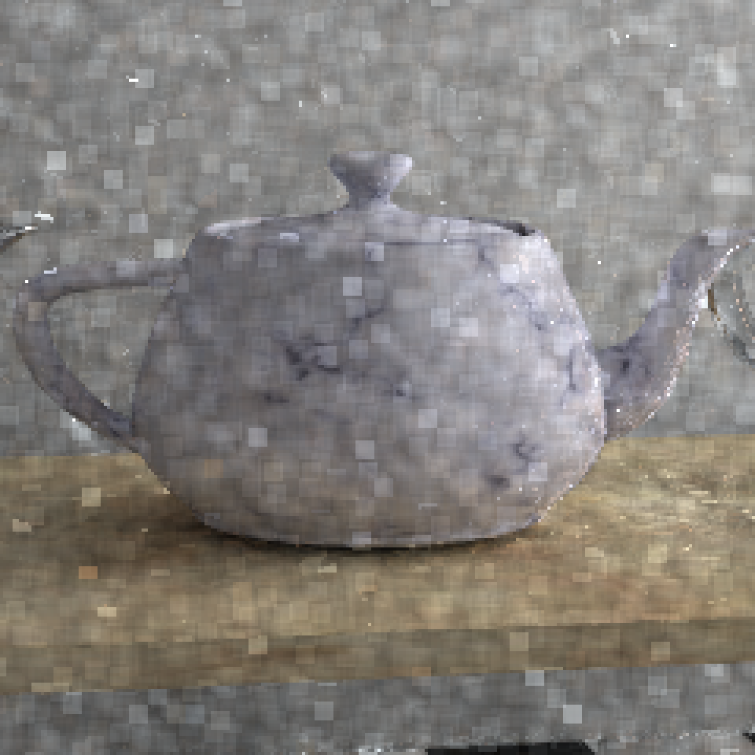
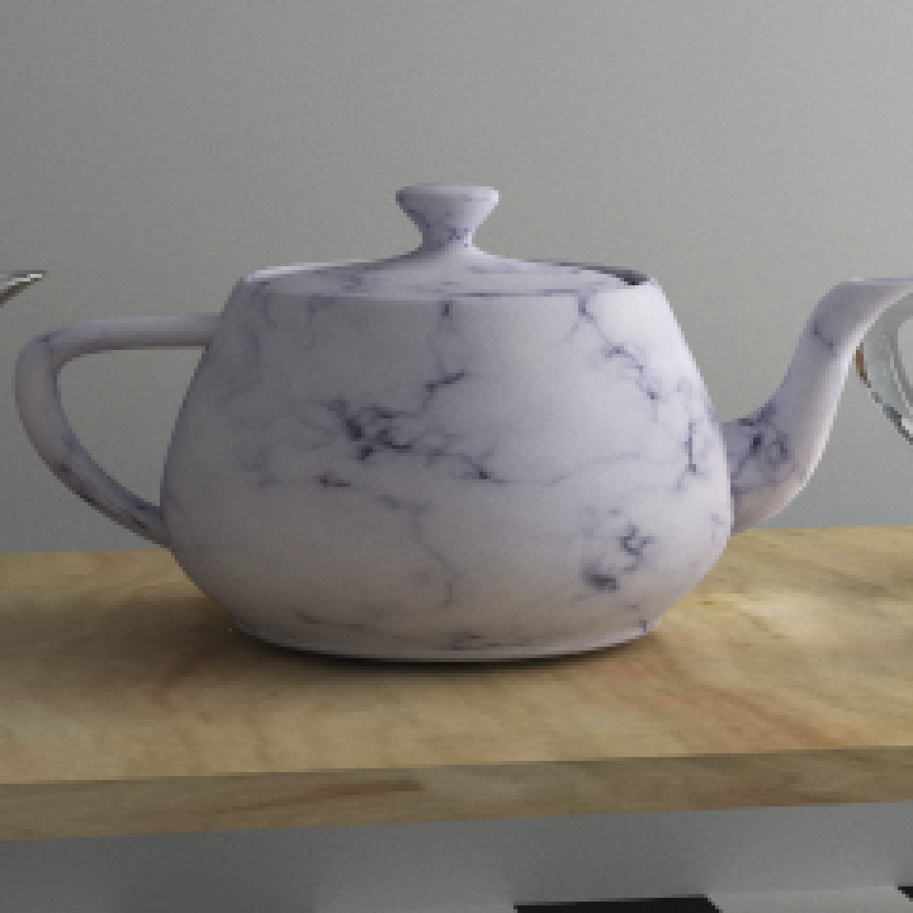
PATH REUSing
Gradient-Domain Path Reusing [Bauszat et al., 2017]
Make the connection between gradient-domain and path reuse [Bekaert et al. 2002]
Uses overlapping square tiles and perform a Poisson reconstruction
Poisson reconstruction
Notes:
This is the approached proposed by gradient-domain path reusing. In fact, shifting a path inside a tile have been explored in path reuse before. This paper brings two new ideas:
1) Apply shift mapping operator used in gradient-domain rendering for path reuse. Before this, path reuse was not efficient on specular or glossy surfaces.
2) The overlapping of the tiles and the Poisson reconstruction process can be used to reduce the image artefacts introduced by the path reuse.

Slide 7
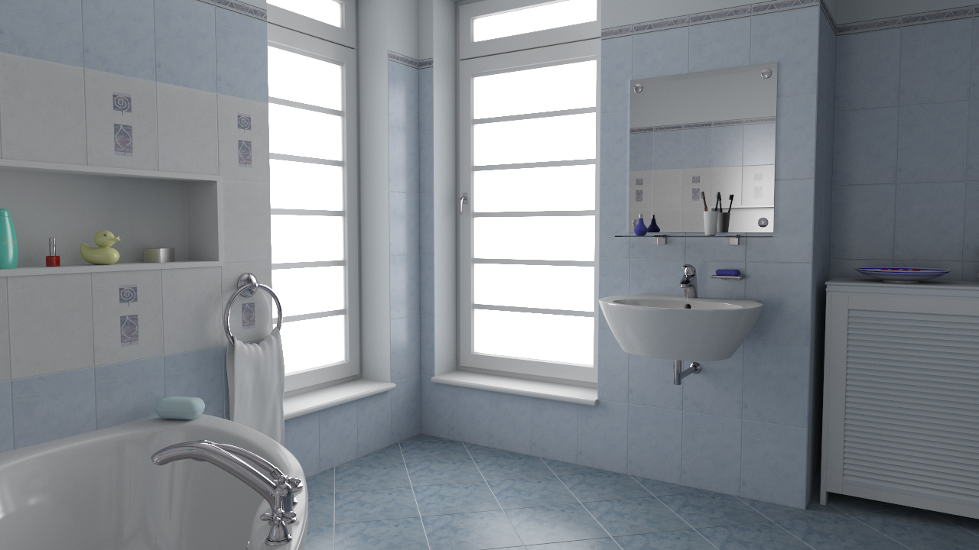
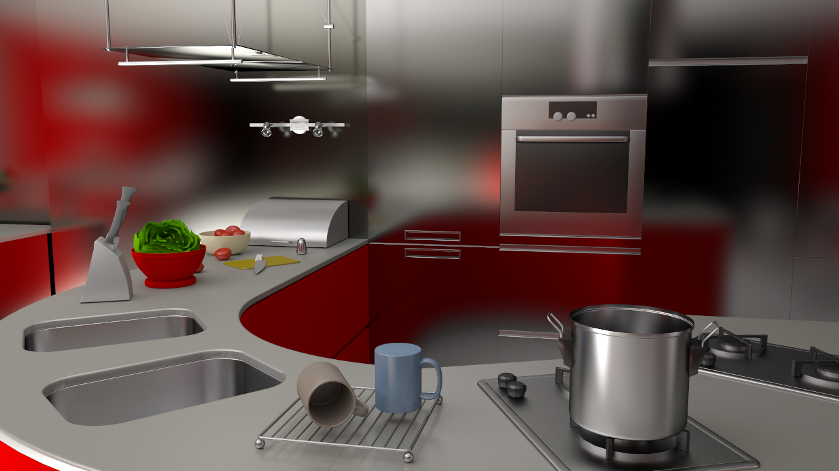

PATH REUSing
relMSE
Efficiency = $\frac{1}{error ∗ time}$
Error to reference
  Figure courtesy of Bauszat et al. [2017]
Notes:
One question is what is the tile size we should use? Inside their paper, the authors have done a small experiment on two scenes by plotting the relative error when increasing the tile size. We can see that small tile size have the largest error. However, at a certain point, too big tile did not bring any benefits.
The authors also plot another curve that takes rendering time into account. This curve shows that using too big tiles is not the good idea. The reason is that bigger tiles means more shift mapping to be performed, which is costly.
The conclusion from this paper is that the optimal tile size is around 6 to 7 pixels.

Slide 8
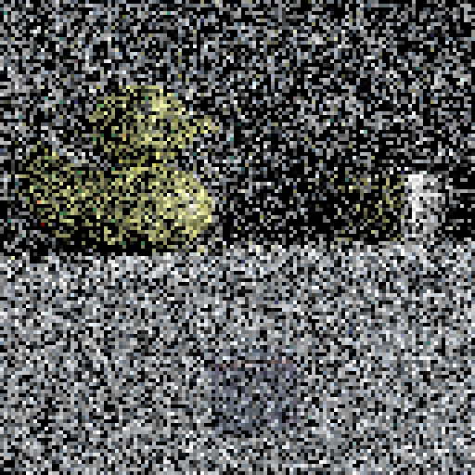
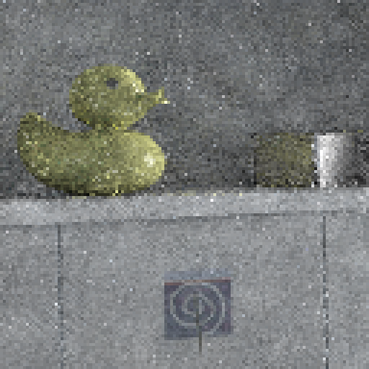
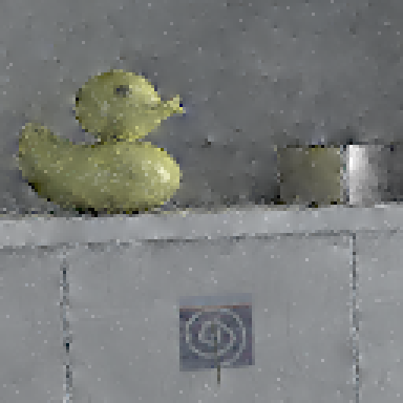
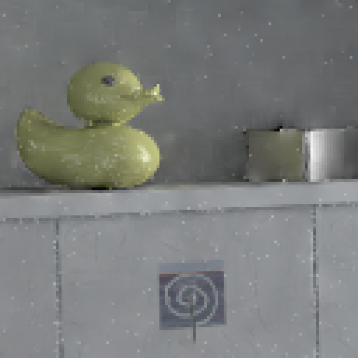
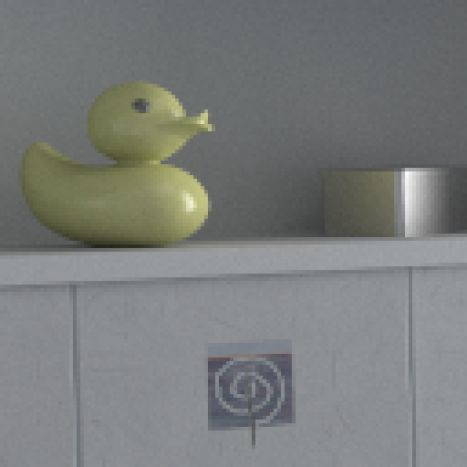
PATH REUSing
Path tracing
Path reusing
G-PT
cross
G-PT
tile (6)
Reference
  Figure courtesy of Bauszat et al. [2017]
Notes:
Here are some results about this technique. We can see their methods can achieve better results compared to classical G-PT with cross shape and primal-domain path reusing. Note that inside this paper the authors use a Russian Roulette to select the path to shift. Please refer to the paper for more details.

Slide 9
NON-CONTIGUOUS PIXELS
Cross shape
Tiles
Non-contiguous
Notes:
So far we only consider axis-aligned kernels. In general, the kernels can have arbitrary shapes.

Slide 10
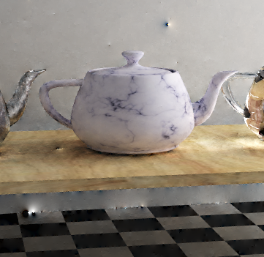


SAMPLING EDGES
L2 reconstruction at edges has bumpy artefacts
Notes:
This is motivated by the fact that conventional shift mapping usually have issues with geometrical edges.

Slide 11
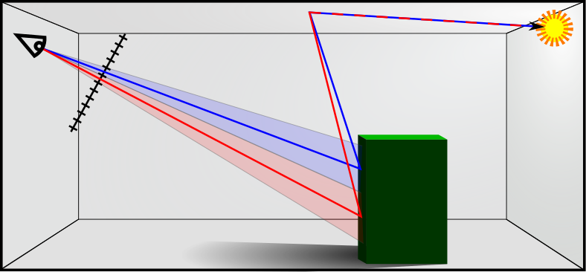
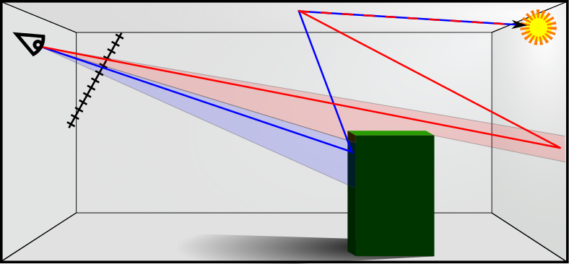
SAMPLING EDGES
Shift mapping performance depends on the integral correlation
High correlation
Low variance gradients
Low correlation
High variance gradients
Notes:
The reason of this problem is due to high variance inside the gradients. Indeed, when two pixels see the similar area, their integral are very similar. In this case shift mapping operator can perform low variance estimate of the gradient value. However, if now we are at the edge, the two primary points can end up to be very far away. This is problematic as their integral will be very different and correlate these two pixels will leads to high variance gradients.

Slide 12
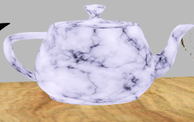
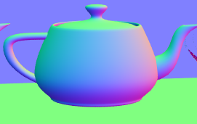

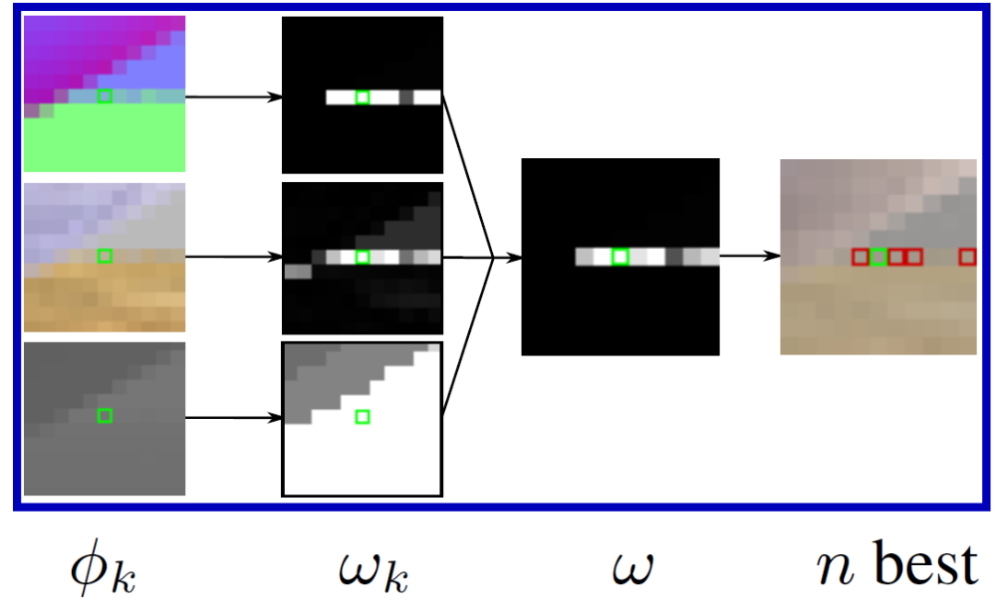


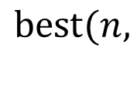

SAMPLING EDGES
Improved Sampling for Gradient-Domain Metropolis Light Transport [Manzi et al. 2014]
Textures
Normals
Depth
$$best⁡(n,$$
$$min⁡($$
$$,$$
$$,$$
$$)$$
$$)$$
Notes:
The idea of Manzi et al. [2014] is to detect similar pixel values in a window and compute the finite difference for arbitrary pairs of pixels in this similar pixel set to reduce gradient variance. They define an affinity function that uses feature buffers to compute the similarity score. This is similar to what has been used in image-space denoising techniques as they assume that feature buffers in general are very similar to the final image.
To define the kernel shape, the authors proposed the following way. For each pixel we look at a window of the different feature maps. For each feature map, a weight such as bilateral filtering weight is computed. Then the N best similar pixels are extracted based on such weights. These pixels will be used to determine where to shift the path.

Slide 13
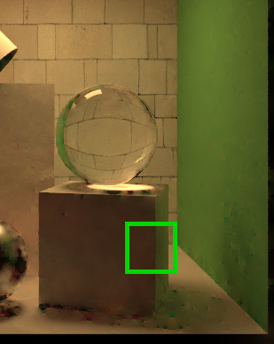
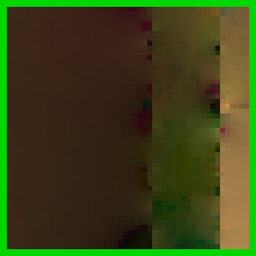
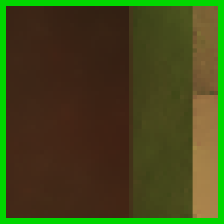
SAMPLING EDGES
Contiguous kernels
Non-contiguous kernels
Notes:
This is a comparison between old gradients and this generalized gradient formulation. We can see that this generalized gradient formulation works much better on the edges. Note that in case of MIS usage, the shift mapping need to be reversible. So extra care need to be done here. Moreover, as the gradient does not have structure anymore, the reconstruction algorithm might be a little bit more complex to implement. For details, please refer to the paper.

Slide 14
Advanced Sampling
Notes:
Now let’s talk about the last point of this state of the art for gradient-domain techniques: advanced sampling.

Slide 15
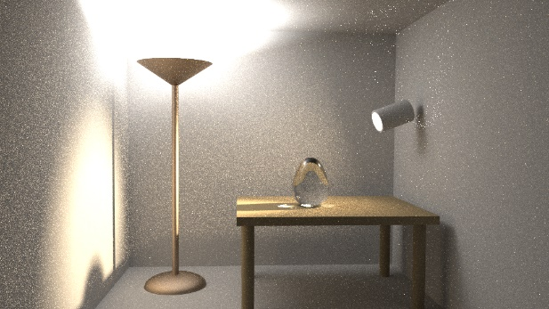
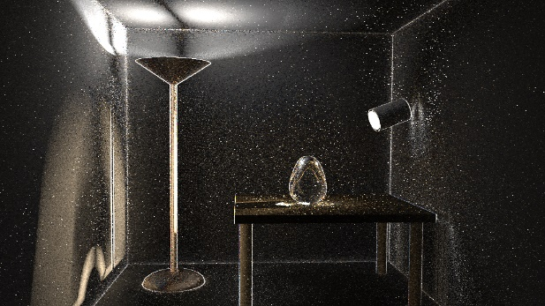
Adaptive Sampling
Primal
Gradients
Notes:
Adaptive sampling is a classical approach for primal rendering techniques. For faster convergence, we want to concentrate samples to the area of higher error to improve the efficiency.
In gradient-domain rendering, we can also apply adaptive sampling. A simple approach that works well is to adaptively sample pixels that has high variance in primal-domain value estimation or gradient value estimation.

Slide 16
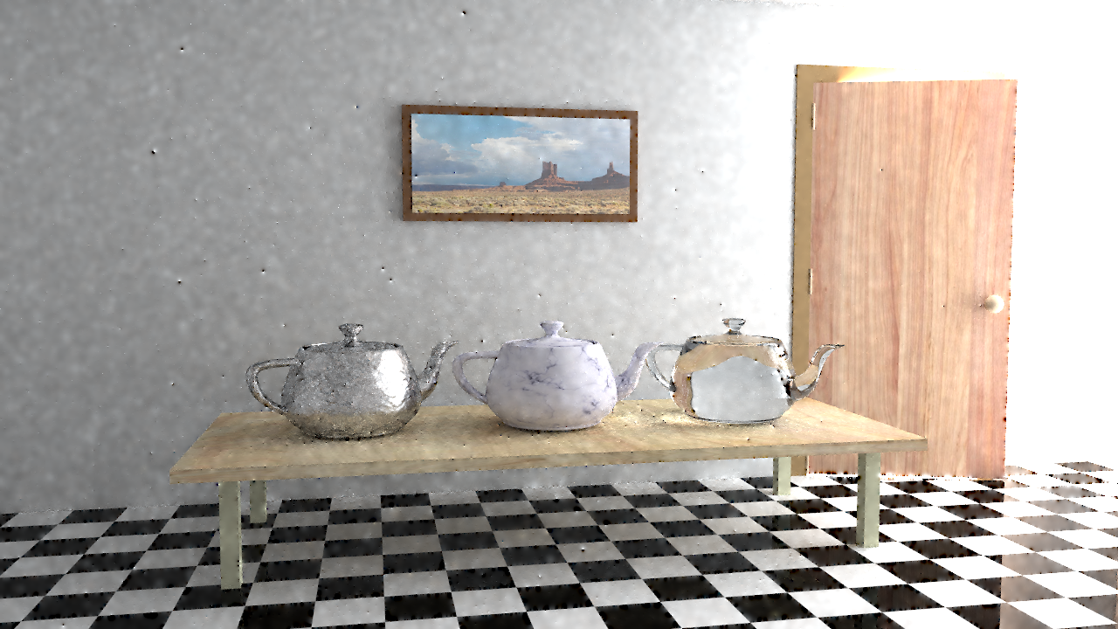
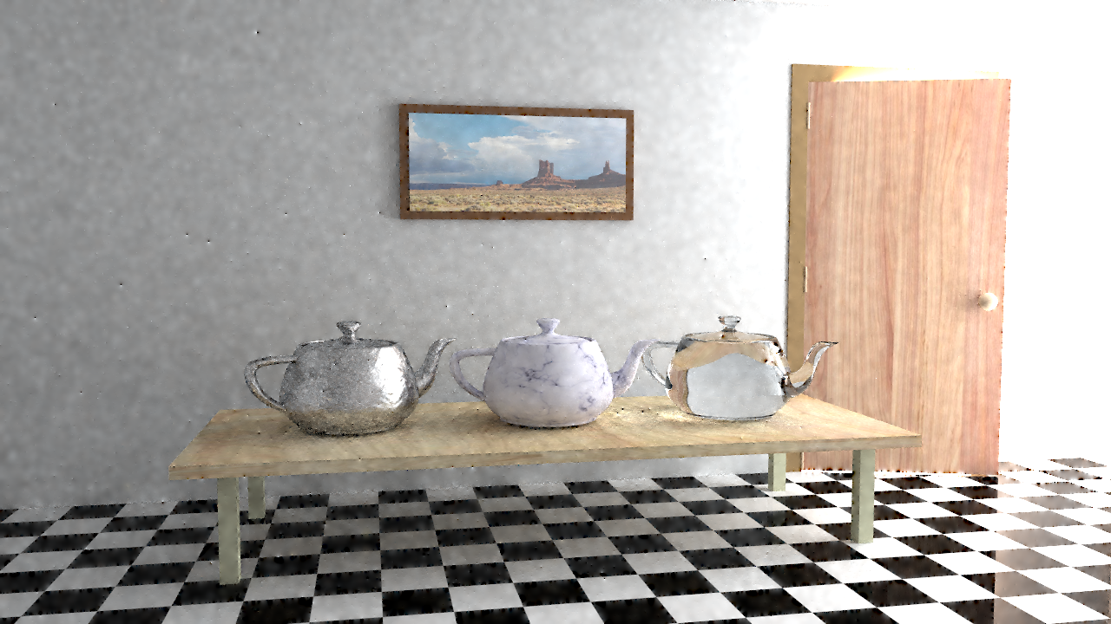
ADAPTIVE GRADIENT-DOMAIN
PATH TRACING
Uniform sampling
Adaptive sampling
Notes:
These are results of gradient-domain path tracing using uniform sampling and adaptive sampling. The reconstruction is done with uniform control variate (similar to L2-norm Poisson reconstruction). The image looks quite the same at first, however, when we zoom on edges regions …

Slide 17
ADAPTIVE GRADIENT-DOMAIN
PATH TRACING
Uniform sampling
Adaptive sampling
Notes:
… we can see that adaptive sampling reduces the artefacts compared to uniform sampling. Note that the effect that we get is similar to non-contiguous kernel as this technique reduce the variances inside problematic gradients.

Slide 18
LOCAL REGRESSION ADAPTIVE METHOD
Path tracing
Color image
Features
Local regression based
reconstruction
Sampling map
(Adaptive sampling)
  WLS [Moon et al. 2014]
  ALP [Moon et al. 2015]
  NFOR [Bitterli et al. 2016]
  APR [Moon et al. 2016]
  Figure courtesy of Back et al., 2018.
Final output

Slide 19
LOCAL REGRESSION ADAPTIVE METHOD
Gradient-domain
Path tracing
Gradients
Color image
Features
Local regression based
reconstruction
Sampling map
(Adaptive sampling)
Reconstruction
  Figure courtesy of Back et al., 2018.
  Feature Generation for Adaptive Gradient-Domain Path Tracing [Back et al., 2018]
Final output

Slide 20
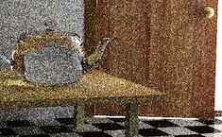
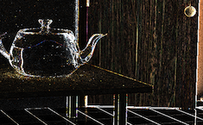
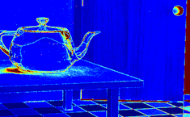
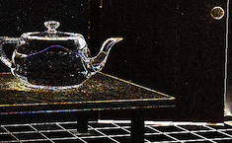
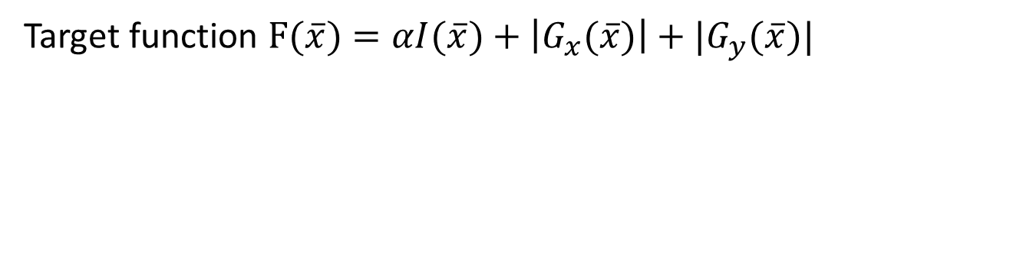
METROPOLIS LIGHT TRANSPORT
Target function $F(\overline{x})=αI(\overline{x})+\left|G_{x}(\overline{x})\right|+|G_{y}(\overline{x})|$
Primal
Sampling density
Gradients
Gradient-Domain Metropolis Light Transport [Lehtinen et al., 2013]
Notes:
We can also rely on MCMC sampling to importance sample the gradients.
Using gradient-domain rendering and MCMC has been explored in the seminal paper by Lehtinen et al. [2013]. This method focus the samples on the gradients.

Slide 21
METROPOLIS LIGHT TRANSPORT
Automatic
importance sampling
Unpredictable results
(MCMC problems)
Primal
Sampling density
Gradients
Gradient-Domain Metropolis Light Transport [Lehtinen et al., 2013]
Notes:
However, implementing MCMC can be tricky to do. It also comes with major drawback such as unpredictable convergence, sudden fireflies and so on.

Slide 22
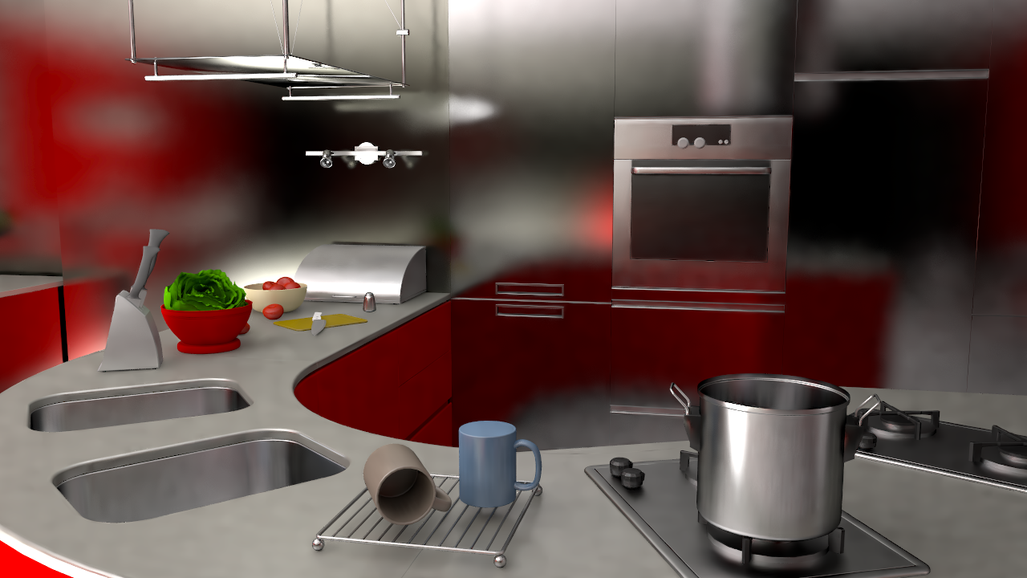

Slide 23
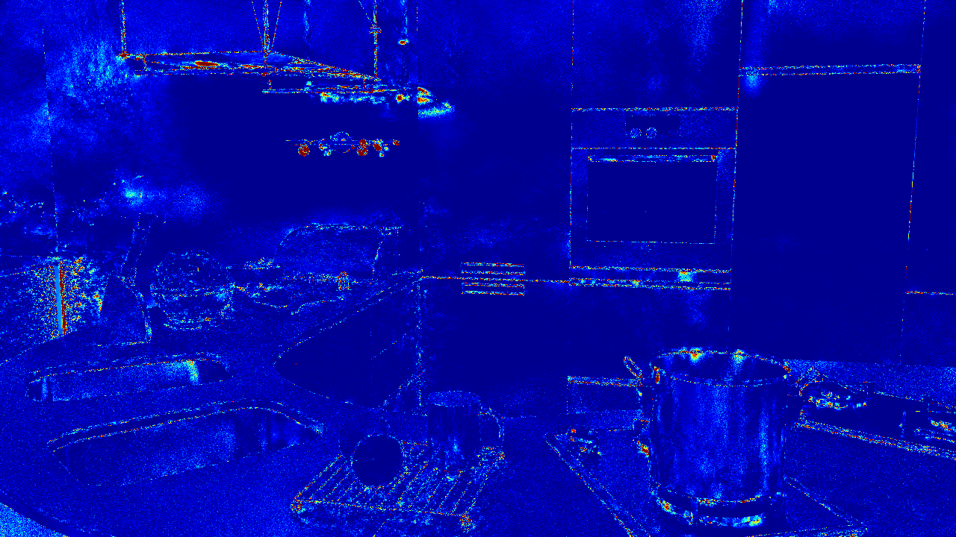
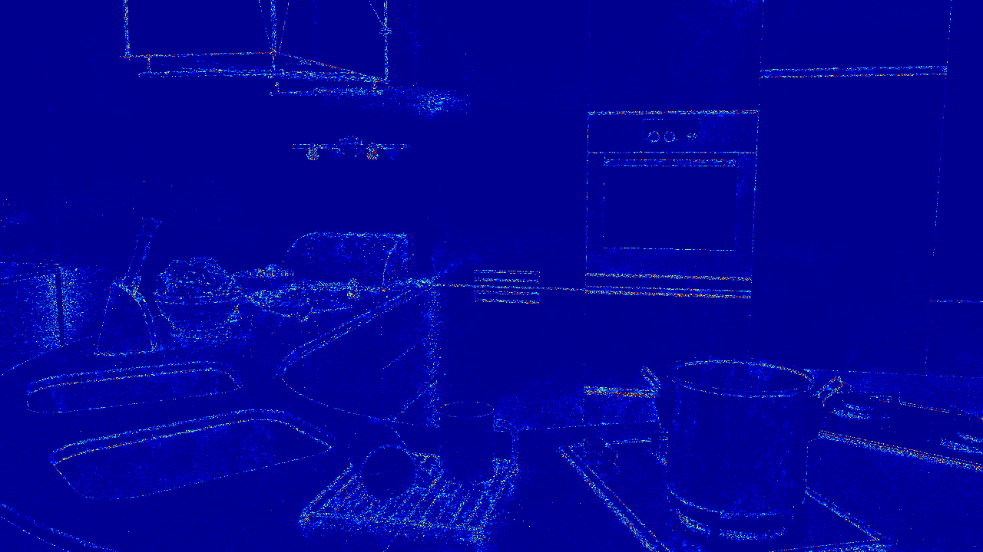
Gradient MLT, 512 spp
Gradient PT, 512 spp
Notes:
Let’s see an example. Standard Metropolis generally does better than standard path tracing when light transport is extremely challenging. However, its convergence is unpredictable and non-uniform as seen in the splotchiness in the error image on the left. While Gradient Metropolis generally improves the situation, it unfortunately inherits the convergence issues.
In contrast, well-implemented standard path tracing beats MLT in easy transport situations, and converges predictably.

Slide 24
Higher dimensional integrals

Slide 25
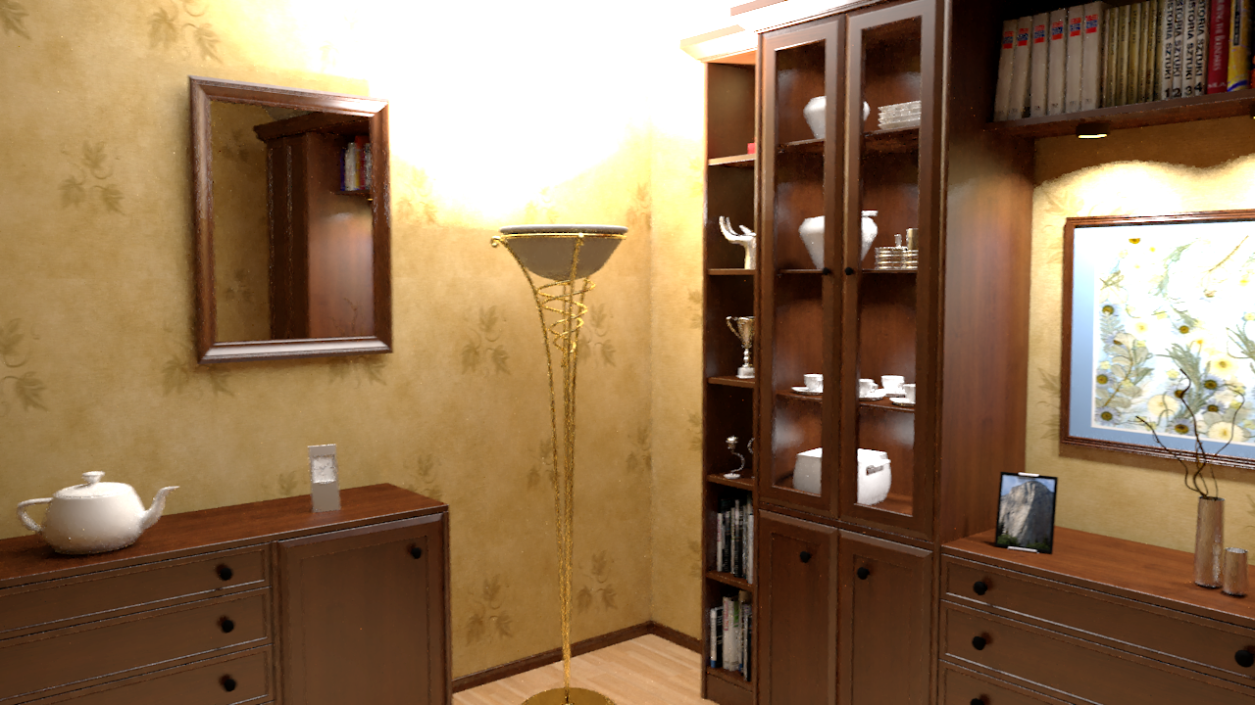
HIGHER DIMENSIONAL integrals
2D image
Notes:
So we just saw how to extend gradient-domain to a sequence of images by taking into consideration the temporal domain. However, these images are still using RGB as their internal image representation. What about spectral rendering? Indeed, in spectral rendering, we need to estimate the distribution of energy across wavelengths for a given pixel. As you can guess, we can use a gradient-domain idea to better estimate this distribution compared to conventional rendering techniques.

Slide 26
HIGHER DIMENSIONAL integrals
2D image
Sequence of
2D images
Notes:
So we just saw how to extend gradient-domain to a sequence of images by taking into consideration the temporal domain. However, these images are still using RGB as their internal image representation. What about spectral rendering? Indeed, in spectral rendering, we need to estimate the distribution of energy across wavelengths for a given pixel. As you can guess, we can use a gradient-domain idea to better estimate this distribution compared to conventional rendering techniques.

Slide 27
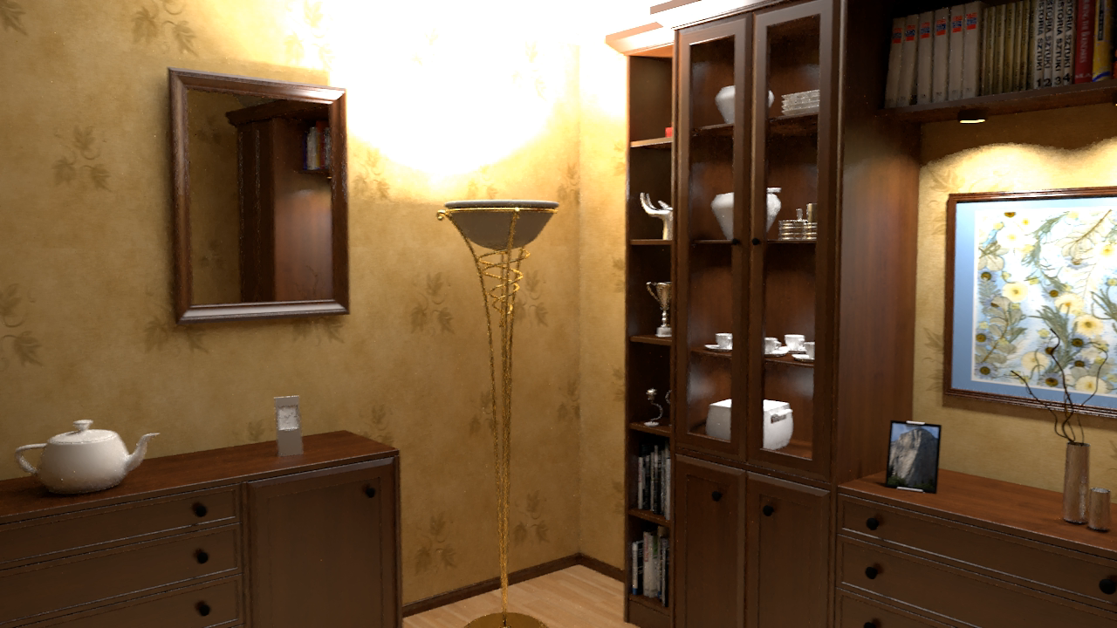
1# Temporal domain
Gradient-domain path tracing
[Kettunen et al. 2015]
Notes:
A naïve extension to support a sequence of images is to treat each image (or frame) independently. For each frame, we can compute primal and gradient values, and apply a Poisson reconstruction. This simple approach generates this kind of results.
We can see that, individually, the Poisson reconstruction generates quite smooth images for each frame. However, as the reconstruction is independent, low-frequency noise is visible when playing the animation. One way to reduce this artifact is to take into account the temporal domain and do the reconstruction across multiple frames.

Slide 28
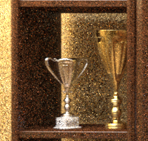
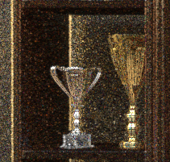
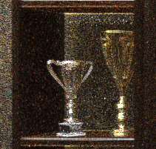

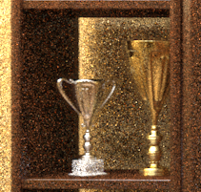
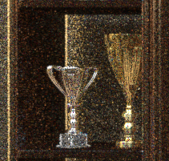
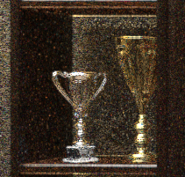


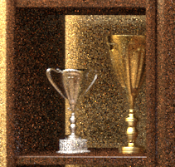
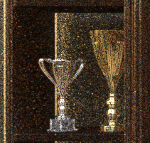
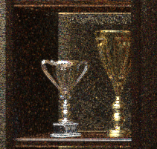
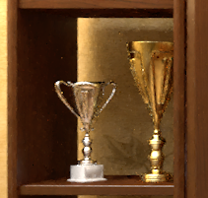
TEMPORAL DOMAIN
Temporal gradient-domain path tracing [Manzi et al. 2016]
Color Image
Spatial Gradients
Reconstruction
Notes:
To add temporal domain to gradient-domain rendering, we need to perform the reconstruction on several frames at a time. For memory cost, we only consider a small window of consecutive frames. However, some important information is missing here.

Slide 29
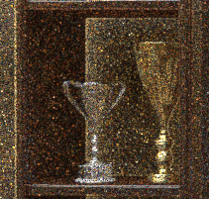
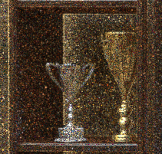
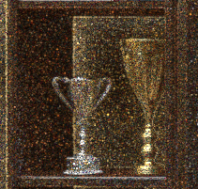
TEMPORAL DOMAIN
Temporal gradient-domain path tracing [Manzi et al. 2016]
3D
2D
Color Image
Spatial Gradients
Temporal Gradients
Reconstruction
Notes:
Indeed, we need to know the temporal gradients between frames. Moreover, as we perform the reconstruction on different images at the same time, we need to do a 3D Poisson reconstruction. We will not detail the reconstruction part and only show how to compute these temporal gradients.

Slide 30
IMAGE-SPACE GRADIENTS
Computing: (dx, dy)
Base
Frame t
Pixel: (x, y)
Offset
Frame t
Pixel: (x+1, y)
Shift mapping
Notes:
Remember, when we were computing image-space gradient, we have a base path at the frame T at the position x and y, and we want to generate an offset path inside the same frame but at the location x+1 and y. To do so, we apply shift mapping as what we have learnt so far.

Slide 31


TEMPORAL GRADIENTS
Computing: (dt)
Scene of frame t+1
NOT available yet at time t
Base
Frame: t
Pixel: (x, y)
Offset
Frame: t+1
Pixel: (x, y)
$$(r_{1},r_{2},r_{3},r_{4},…)$$
$$(r_{1},r_{2},r_{3},r_{4},…)$$
Copy random numbers
Notes:
However, when we are computing the gradient in the temporal domain, we want to shift a base path at frame t and generates an offset path at the frame t+1. The problem is that to create this offset path we need to store two scenes in the memory. Moreover, due to the object movement, it is difficult to track spatial information from frame t to frame t+1.
Our solution here is to only store one scene in the memory and rely on a simpler shift mapping. The idea is to capture the random numbers that generate the base paths in frame t, and when the scene for frame t+1 is loaded, we generate the offset paths by replaying such random numbers. This brings a certain level of path coherence, while still keeping memory usage efficient.

Slide 32
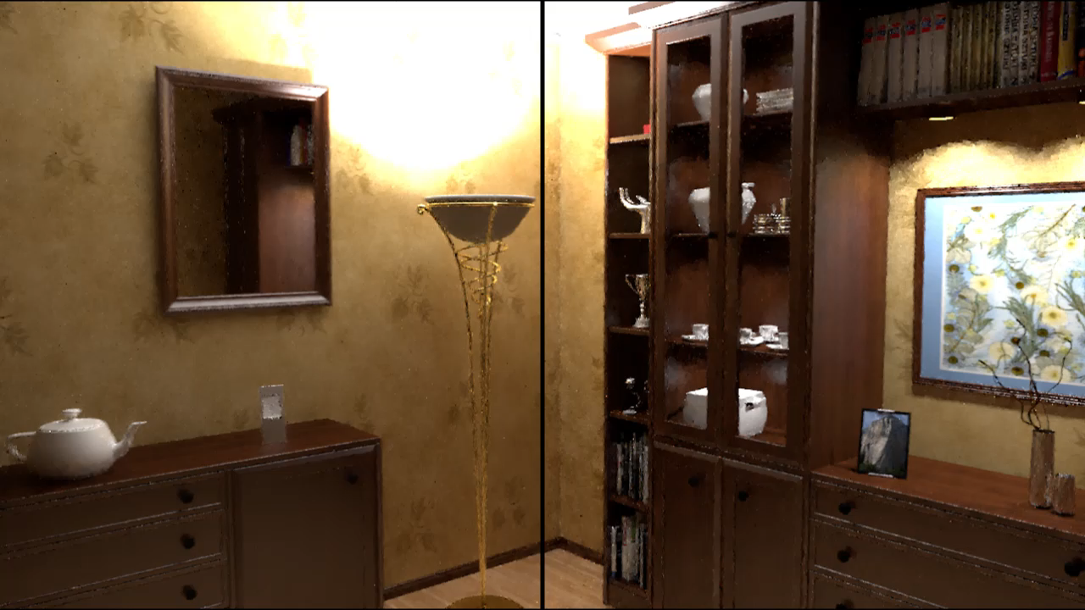
Temporal G-PT (32spp)
G-PT, (equal time)
[Kettunen et al. 2015]
Notes:
Time to look at some results. Here we can see the comparison between temporal G-PT and G-PT with independent reconstruction. We can see that leverage the information of the temporal gradients improve the results in term of reconstruction stability.

Slide 33
HIGHER DIMENSIONAL integrals
2D image
Sequence of
2D images
Volume
Rendering
Notes:
So we just saw how to extend gradient-domain to a sequence of images by taking into consideration the temporal domain. However, these images are still using RGB as their internal image representation. What about spectral rendering? Indeed, in spectral rendering, we need to estimate the distribution of energy across wavelengths for a given pixel. As you can guess, we can use a gradient-domain idea to better estimate this distribution compared to conventional rendering techniques.

Slide 34
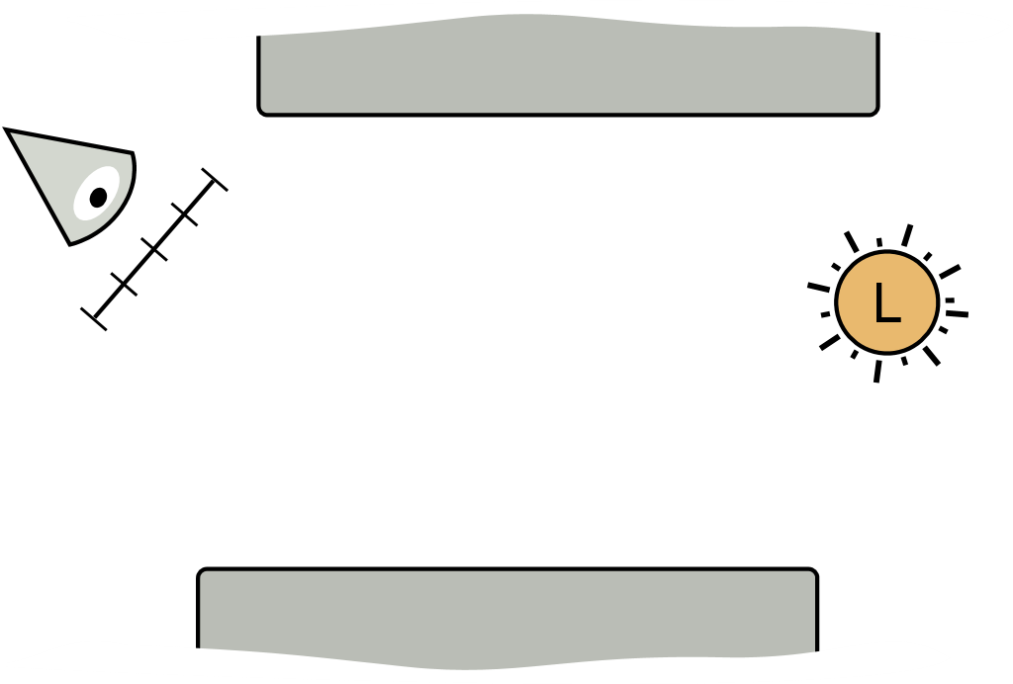
Volume rendering
Surface rendering

Slide 35
Volume rendering
Surface rendering
Volumetric rendering

Slide 36

Volume rendering
Surface rendering
Volumetric rendering
$$∫$$

Slide 37

Volume rendering
Surface rendering
Volumetric rendering
$$t$$

Slide 38
VOLUMETRIC RENDERING
Sampling distance
Specialized techniques
Volumetric Path Tracing
Volumetric Bidirectional Path Tracing
[Lafortune et al. 1996]
Volumetric Photon Mapping
[Jensen et al. 1998]
Beam Radiance Estimate [Jarosz et al. 2008]
Photon Beams
[Jarosz et al. 2011]
Photon Planes & Volumes [Bitterli et al. 2017]

Slide 39
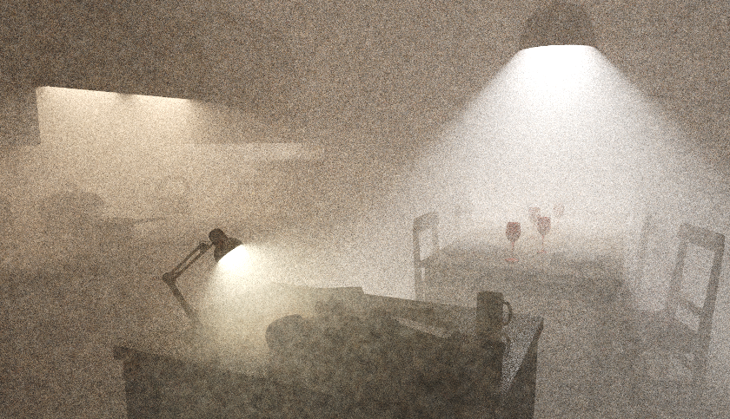

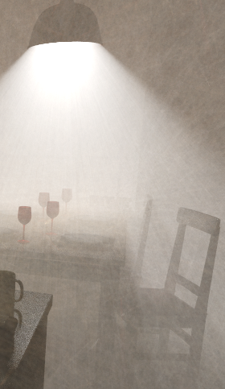
5 minutes
Volumetric Photon Mapping
Beam Radiance Estimate
Photon Beams
Notes:
Here are the results for a smoky kitchen scene with 5 minutes of rendering. This scene have been rendered with different photon density estimators. For this particular scene, photon beams provide the best result for the same rendering time.

Slide 40
Volume rendering
“Classical”
Rendering
Gradient-domain Rendering
Shift Mapping
Volumetric
G-PT, G-BDPT
G-VPM
G-BRE
G-Photon Beams
G-Photon Planes
Volumetric
PT, BDPT, PM
New shift mapping operators
Specialized techniques
BRE, Photon Beams, …
“Gradient-domain Volumetric Photon Density Estimation” Gruson et al.
Notes:
Inside our last SIGGRAPH paper, we have explored a wide variety of gradient-domain rendering technique for the volume. Due to time constraints here, I will only focus on volumetric photon mapping, beam radiance estimate, and photon beams. For other rendering techniques please refer to the original paper.

Slide 41

Gradient-domain VOLUMETRIC PHOTON MAPPING
Fresnel boundary
Medium
Diffuse
Notes:
First, we will shift the camera subpath. To do so, an offset camera subpath is generated at the neighbor pixel with half-vector copy correlate this subpath to the base camera subpath. Note that during this generation, we do not consider interactions with the volume.

Slide 42
Gradient-domain VOLUMETRIC PHOTON MAPPING
Fresnel boundary
Medium
Diffuse
Notes:
First, we will shift the camera subpath. To do so, an offset camera subpath is generated at the neighbor pixel with half-vector copy correlate this subpath to the base camera subpath. Note that during this generation, we do not consider interactions with the volume.

Slide 43

Gradient-domain VOLUMETRIC PHOTON MAPPING
Fresnel boundary
$$t$$
Medium
Diffuse
Notes:
First, we will shift the camera subpath. To do so, an offset camera subpath is generated at the neighbor pixel with half-vector copy correlate this subpath to the base camera subpath. Note that during this generation, we do not consider interactions with the volume.

Slide 44
Gradient-domain VOLUMETRIC PHOTON MAPPING
Fresnel boundary
Medium
Diffuse
Notes:
Then we need to decide where to perform the density estimation on the offset sensor path.
We have tried several approach during this project and the simplest approach have been working the best in general: we just copy the distance sampled on the base path to the sensor path.
This offset distance is used to place the offset photon density kernel. We also uses the same radius for base and offset kernel. Now we have completely shift the sensor subpath. Let’s now see how to shift the light subpath.

Slide 45
Gradient-domain VOLUMETRIC PHOTON MAPPING
Fresnel boundary
Medium
Diffuse
Notes:
Then we need to decide where to perform the density estimation on the offset sensor path.
We have tried several approach during this project and the simplest approach have been working the best in general: we just copy the distance sampled on the base path to the sensor path.
This offset distance is used to place the offset photon density kernel. We also uses the same radius for base and offset kernel. Now we have completely shift the sensor subpath. Let’s now see how to shift the light subpath.

Slide 46
Gradient-domain VOLUMETRIC PHOTON MAPPING
Fresnel boundary
Medium
Diffuse
Notes:
So, to shift the light subpath, we need first to deduce the position of the offset photon.
After finding this position, we can generate the offset light subpath by reusing the base light subpath as soon as possible. For example, here we can directly reconnecting to the parent photon of the base light subpath.

Slide 47
Density estimation paths
Volumetric Photon Mapping (3D)
Beam Radiance Estimates (2D)
Photon Beams
(1D)
Notes:
So far we have been talking only about volumetric photon mapping and how to shift a complete path. However, what’s about other rendering techniques like beam radiance estimate and photon beams.

Slide 48
Density estimation paths
Volumetric Photon Mapping (3D)
Beam Radiance Estimates (2D)
Photon Beams
(1D)
Notes:
Which shift mapping operation can be used to brings these technique into gradient-domain? The answer in short: the shift mapping operator for other techniques are similar to the volumetric photon mapping case. Only the kernel constraints changes the shift mapping operator.

Slide 49
Favoring 3D kernels
Volumetric Photon Mapping (3D)
Beam Radiance Estimates (3D)
Photon Beams
(3D)
[Hachisuka et al. 2017]
Extended Path Integral Formulation for Volumetric Transport
Notes:
… the technique by Hachisuka et al. [2017] which allows us to increase the photon density kernel dimensionality to 3D kernel for all these techniques. Using 3D kernel makes the shift mapping simpler at the cost of adding a bit of bias due to an higher dimensional kernel.

Slide 50
5 minutes
Volumetric Photon Mapping
Beam Radiance Estimate
Photon Beams
Notes:
Now let’s look at some results. Here, again, the results for the smoky kitchen scene with 5 minutes of rendering. These are the results of different rendering techniques without gradient computation (primal-domain techniques).
Now let’s look at gradient-domain counterpart.

Slide 51



5 minutes
Gradient-domain
Volumetric Photon Mapping
Gradient-domain
Beam Radiance Estimate
Gradient-domain
Photon Beams
Notes:
It is easy to see that gradient-domain techniques outperform the primal-domain rendering with a wide margin in the same amount of rendering time. (For best view, please flip back and forth.)

Slide 52




0.0
Relative MSE
> 0.2
Volumetric Photon Mapping
Beam Radiance Estimate
Photon Beams
Notes:
Another visualization: we visualize the relative MSE with pseudo colors. Here are the error maps of primal-domain techniques.

Slide 53



0.0
Relative MSE
> 0.2
Gradient-domain
Volumetric Photon Mapping
Gradient-domain
Beam Radiance Estimate
Gradient-domain
Photon Beams
Notes:
And here are the error maps of gradient-domain techniques. In this case, more blue means less errors.

Slide 54
HIGHER DIMENSIONAL integrals
2D image
Sequence of
2D images
Volume
Rendering
Notes:
So we just saw how to extend gradient-domain to a sequence of images by taking into consideration the temporal domain. However, these images are still using RGB as their internal image representation. What about spectral rendering? Indeed, in spectral rendering, we need to estimate the distribution of energy across wavelengths for a given pixel. As you can guess, we can use a gradient-domain idea to better estimate this distribution compared to conventional rendering techniques.

Slide 55
HIGHER DIMENSIONAL integrals
R
G
B
2D image
Sequence of
2D images
Volume
Rendering
Spectral
rendering
Notes:
So we just saw how to extend gradient-domain to a sequence of images by taking into consideration the temporal domain. However, these images are still using RGB as their internal image representation. What about spectral rendering? Indeed, in spectral rendering, we need to estimate the distribution of energy across wavelengths for a given pixel. As you can guess, we can use a gradient-domain idea to better estimate this distribution compared to conventional rendering techniques.

Slide 56
Spectral domain
Image space gradients
Spectral gradients
Notes:
In image-space gradients, we were computing the difference of the base path generated at a given pixel location to their neighbors. The idea in spectral-domain rendering is, within the same pixel, compute the gradient inside the wavelength space. For that, we need to define a new shift mapping to generate the gradients in the wavelength dimension.

Slide 57


Spectral domain
Spectral Gradient Sampling for Path Tracing [Petitjean et al. 2018]
Base path
Offset path
Offset and
Base path
CC by fdecomite
Notes:
The shift mapping proposed by Petitjean and colleague is similar to that in gradient-domain path tracing. Indeed, it relies on half vector copy and diffuse reconnection. However, the difference is the condition of performing the shift mapping. Indeed, as it is within a pixel, the offset and the base path start inside the same pixel. The divergence between these two paths only occurs when we encounter a dispersive object (for example a glass object). When the paths are diverging, half-vector copy is used to keep them coherent. The offset path is merged back to the base path when diffuse reconnection is applicable. Divergence can occur multiple times on the path when several diffractive objects is encounter during tracing.

Slide 58
Spectral domain
Spectral Gradient Sampling for Path Tracing [Petitjean et al. 2018]
R
1D Poisson reconstruction
G
B
Samples and gradients
Reconstructed
distribution
Notes:
After getting the samples for a different wavelength and their gradient, a 1D Poisson reconstruction is performed to reconstruct the wavelength distribution. Then this reconstructed distribution can be converted back to RGB for viewing on a conventional display.

Slide 59

Spectral domain
Spectral Gradient Sampling for Path Tracing [Petitjean et al. 2018]
Notes:
Let’s look at some results. Note, here; we are only interested in the color noise and not the noise across pixels as we only perform a 1D reconstruction to smooth out noise in the wavelength distribution. Compared to the non-gradient technique, their method can achieve variance reduction thanks to their specialized shift mapping and 1D Poisson reconstruction. Note that if we combine spatial gradient and wavelength gradient using a 3D Poisson reconstruction, we should be able to clean out the noise across pixels. This is left as a future work.

Slide 60
HIGHER DIMENSIONAL integrals
R
G
B
2D image
Sequence of
2D images
Volume
Rendering
Spectral
rendering
Notes:
So we just saw how to extend gradient-domain to a sequence of images by taking into consideration the temporal domain. However, these images are still using RGB as their internal image representation. What about spectral rendering? Indeed, in spectral rendering, we need to estimate the distribution of energy across wavelengths for a given pixel. As you can guess, we can use a gradient-domain idea to better estimate this distribution compared to conventional rendering techniques.

Slide 61
SUMMARY
Robust reconstruction
Advanced sampling
Higher dimensional integrals
Notes:
Let’s conclude this section. We talked about various topics in advanced gradient-domain rendering Note that many of the techniques can be combined. It would be interesting to see more advanced techniques coming in the near future.

