Slide 1
Image Reconstruction
Binh-Son Hua
The University of Tokyo
Notes:
We have now gained enough background to discuss the state of the arts in gradient-domain rendering. We will explain more advanced topics that have not been covered so far. Most of these works are orthogonal and can be built on top of the gradient-domain rendering algorithms that you learn. Let’s start.

Slide 2
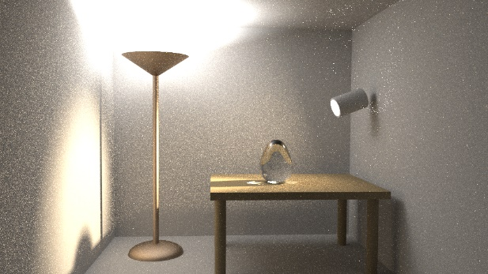
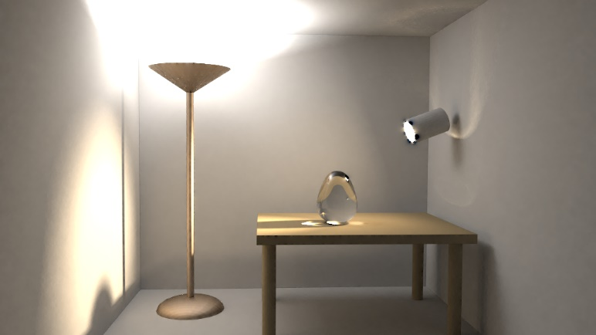
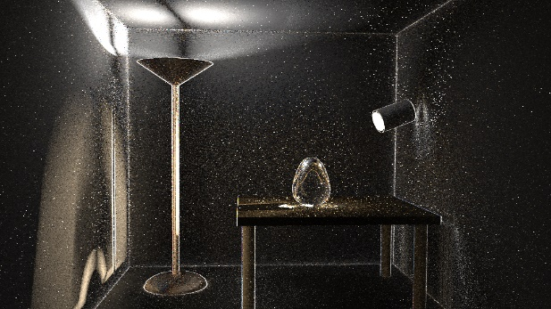
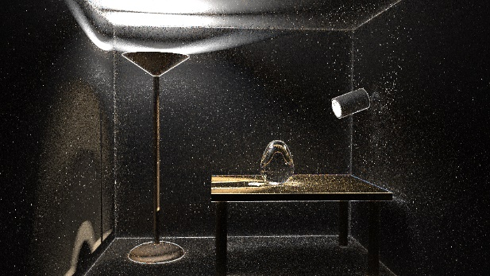
IMAGE RECONSTRUCTION
Find an image that best fits the estimated primal & gradients
Primal
image
Gradients
Notes:
So now, to summarize, to estimate the gradients, we use a special hybrid shift mapping.
In order to get a consistent estimator, we can use the same reduction rate as stochastic progressive photon mapping [Hachisuka et al., 2009].

Slide 3
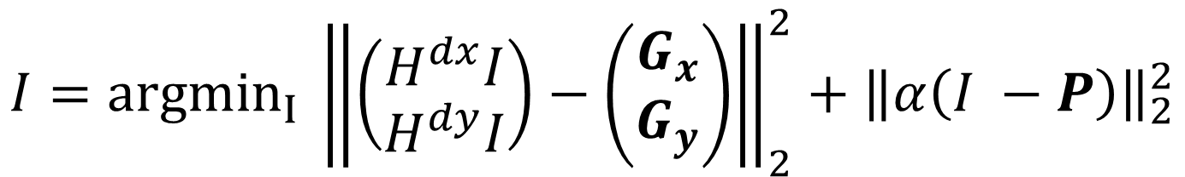
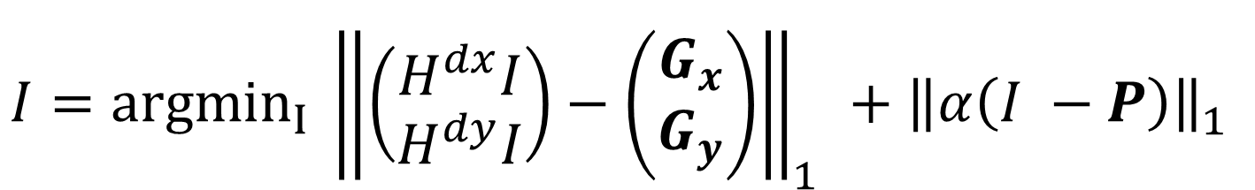
POISSON RECONSTRUCTION
L2-norm reconstruction
[Lehtinen et al., 2013]
$$I={argmin}_{I} {\left\|\left(\begin{matrix}H^{dx}I \\ H^{dy}I\end{matrix}\right)−\left(\begin{matrix}G_{x} \\ G_{y}\end{matrix}\right)\right\|}_{2}^{2}+{\left\|α\left(I −P\right)\right\|}_{2}^{2}$$
Gradient term
Primal term
L1-norm reconstruction
$$I={argmin}_{I} {\left\|\left(\begin{matrix}H^{dx}I \\ H^{dy}I\end{matrix}\right)−\left(\begin{matrix}G_{x} \\ G_{y}\end{matrix}\right)\right\|}_{1}^{}+{\left\|α\left(I −P\right)\right\|}_{1}^{}$$
Gradient term
Primal term
Notes:
As seen in the previous sections, image reconstruction is basically a Poisson reconstruction problem. It takes the primal image P and the image-space gradients (Gx, Gy) to reconstruct a final image I. The L2 formula opts to minimize the difference of a gradient-based term and a primal-based term. Here H is the finite difference operator. This last term is also called a regularization term and the alpha parameter controls how strong the output should favor similarity to the primal or gradients.
This problem is a least squared minimization problem and iterative solvers like conjugate gradients can be applied directly.
Let’s now discuss another algorithm.

Slide 4
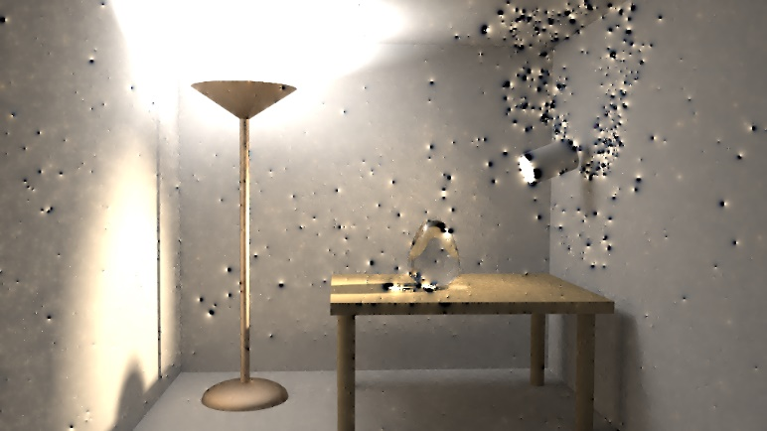
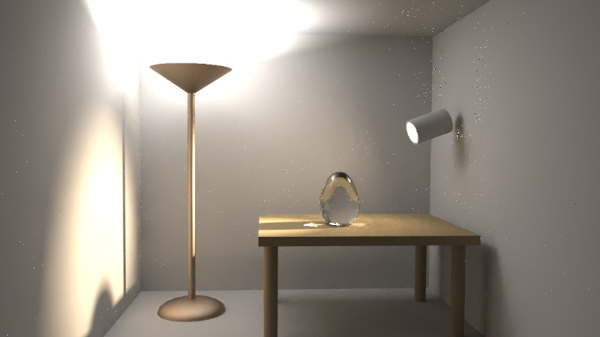
OUTLIERS IN THE RECONSTRUCTION
L1
L2
Notes:
L2 is unbiased but has more visual artifacts. L1 reduces artifacts but could lead to energy loss.
Here is a comparison. In principle, L2 reconstruction should work when the gradient samples are not too noisy, e.g., no spikes. When the gradient is noisy, L2 reconstruction usually results in significant visual artifacts. In this case, using L1 usually leads to a better image.

Slide 5
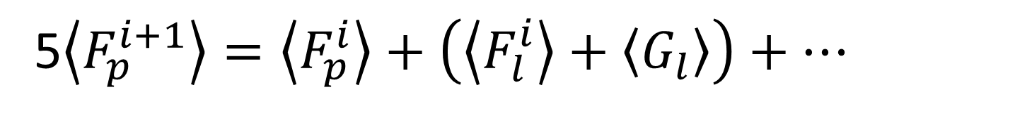

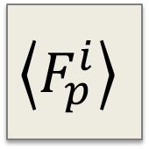
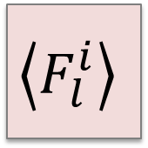
IMAGE RECONSTRUCTION
Reformulate reconstruction as an iterative process:
$$\left\langle G_{l}\right\rangle$$
5$\left\langle F_{p}^{i+1}\right\rangle =\left\langle F_{p}^{i}\right\rangle +\left(\left\langle F_{l}^{i}\right\rangle +\left\langle G_{l}\right\rangle \right)+…$
$$\left\langle F_{l}^{i}\right\rangle$$
$$\left\langle F_{p}^{i}\right\rangle$$
Next iteration
value
Pixel value
Left pixel
Left gradient
Image-space control variate [Rousselle et al., 2016]
Notes:
A simple approach has been proposed recently by Rousselle and colleague. They reformulate the reconstruction problem as an iterative reconstruction.
The key idea is that a pixel value could be well approximated by its neighbor pixel values compensated by the gradients.
At i-th iteration, the value of pixel p (F_p) is an average of itself and its neighbors (F_l) compensated by the gradients between p and l (X_l). Averaging all these values using uniform weights gives the pixel value for the next iteration. The weight is 1/5 in this case due to 4 neighbors and 1 center pixel.

Slide 6

CONTROL VARIATE VS. POISSON
Iterative reconstruction
L2-norm Poisson solver
Pixels values
Iteration = 0
(Noisy inputs)
Alpha =$∞$
Notes:
One question is about the number of iterations that we should use. In fact, the number of iteration is related to the alpha parameter used inside a L2 Poisson solver.

Slide 7
CONTROL VARIATE VS. POISSON
Iterative reconstruction
L2-norm Poisson solver
Pixels values
Iteration = 1
Alpha = 0.94
Notes:
More iteration we do, lower the alpha will be.

Slide 8
CONTROL VARIATE VS. POISSON
Iterative reconstruction
L2-norm Poisson solver
Pixels values
Iteration = 5
Alpha = 0.54
Notes:
You can observe that the two solver converge to the same solution when they relies more on the gradient informations.

Slide 9
CONTROL VARIATE VS. POISSON
Iterative reconstruction
L2-norm Poisson solver
Pixels values
Iteration = 34
Alpha = 0.2
Notes:
Note that this current iterative reconstruction is not a screened Poisson reconstruction. Please refer the paper to more discussion about this particular point. Despite that, this reconstruction have similar properties to a Poisson reconstruction.

Slide 10
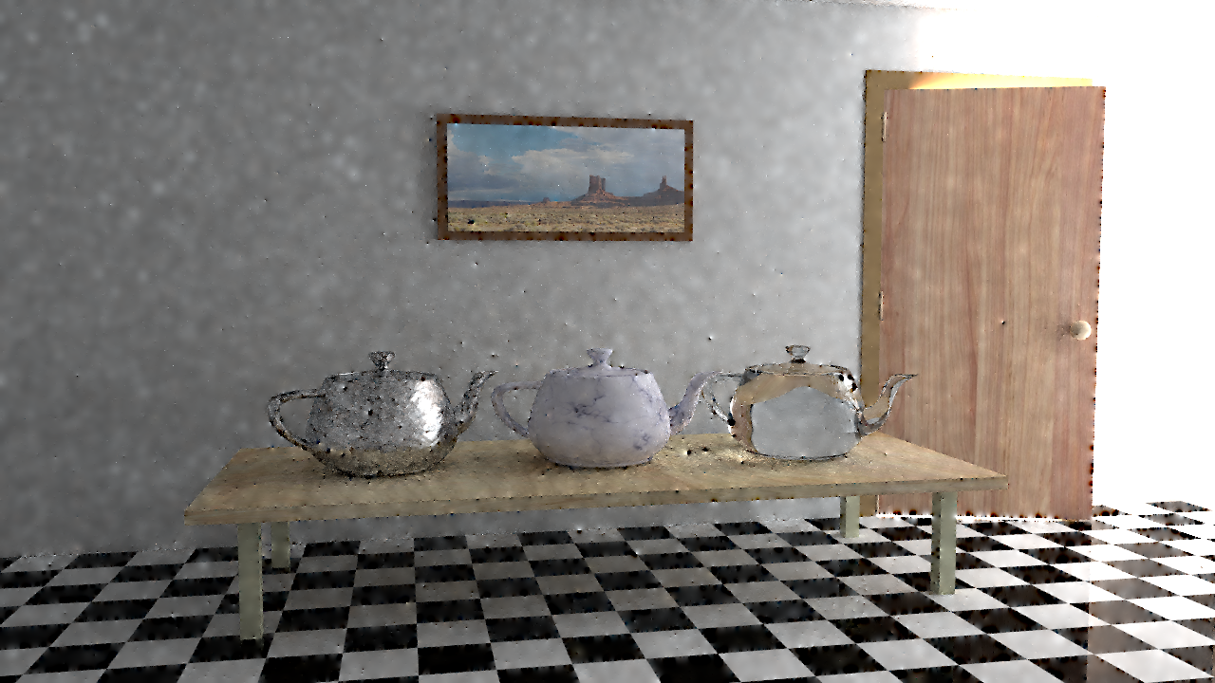

CONTROL VARIATE VS. POISSON
Control variate
L2-norm Poisson reconstruction
Notes:
Let us look at this comparison. Uniform control variate and L2 reconstruction generates very similar results.

Slide 11
CONTROL VARIATE VS. POISSON
Control variate
L2-norm Poisson reconstruction
Notes:
Here are the insets.

Slide 12

CONTROL VARIATE
Weighted reconstruction
Optimally combine estimators at pixel p using its variance inverse.
$$\left\langle F_{p}^{i+1}\right\rangle =w_{p}^{i}\left\langle F_{p}^{i}\right\rangle +w_{l}^{i}\left(\left\langle F_{l}^{i}\right\rangle +\left\langle G_{l}\right\rangle \right)+…$$
$$w_{p}^{i}=\frac{σ_{p}^{−2}}{\sum_{r}{σ_{r}^{−2}}}$$
Image-space control variate [Rousselle et al., 2016]
Notes:
It is possible to optimize the weights for control variates. Usually, the artefacts in the L2-norm Poisson reconstruction is due to high variance primal or gradient values. Using a weight that inversely proportional to the variance can weight down problematic gradients and reduce the reconstruction artefacts.
This weighted reconstruction produces images similar (or better) than L1-norm reconstruction.

Slide 13

WEIGHTED RECONSTRUCTION
Uniform
Weighted
Notes:
Here is the comparison between uniform and weighted reconstruction where the weights are inversely proportional to the estimated variance of the primal pixels. We used an online variance estimation.
For the exact formula of the weights, please see the paper [Rousselle et al., 2016].

Slide 14
WEIGHTED RECONSTRUCTION
Uniform
Weighted
Notes:
We see that weighting down problematic gradients removes the dipole artefacts and leads to better image quality.

Slide 15

WEIGHTED RECONSTRUCTION
L1-norm Poisson reconstruction
Weighted
Notes:
Compared to an L1 reconstruction, a weighted reconstruction seems a bit noiser in this case. However, if we visual the errors…

Slide 16
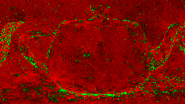
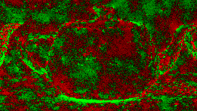
WEIGHTED RECONSTRUCTION
Negative error
Positive error
L1-norm Poisson reconstruction
Weighted
Notes:
… we can see that L1 reconstruction suffer from a large energy loss. In comparison, the weighted reconstruction has more uniform error patterns.

Slide 17
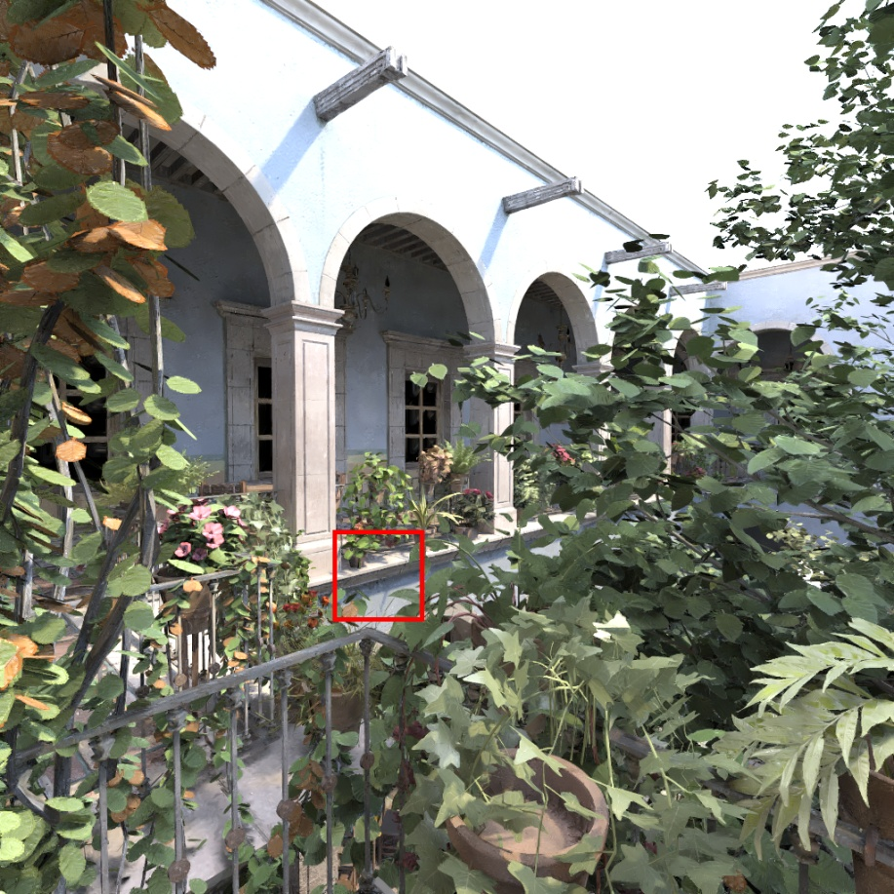
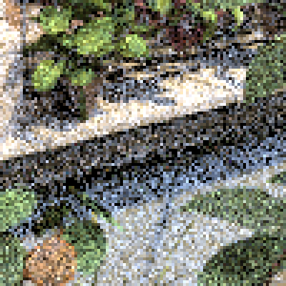
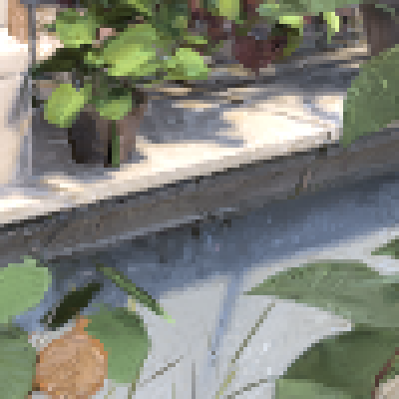
MONte CARLO DENOISERS
Robust Denoising using Feature and Color Information [Rousselle et al., 2013]
Path tracing 55s
Denoising 57s
Notes:
These information is usually used in post-process denoising techniques to filter noise in path tracing. These techniques are applied directly on the primal image. They do not use the estimated gradients from shift mapping that usually have less variance compared to the primal.

Slide 18
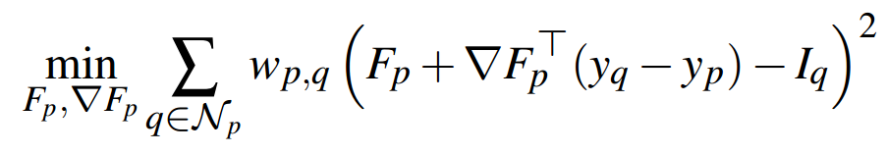
MODERN DENOISERS
Local regression model
Transform feature vector F into color with a linear function
Collaborative filtering, selection-based bandwidth estimation
Nonlinearly Weighted First-order Regression [Bitterli et al., 2016]

Slide 19
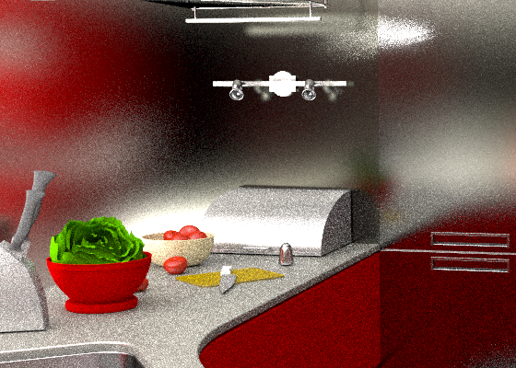



MODERN DENOISERS
Traditional
Gradient-domain
Path tracing
relMSE: 0.129
Gradient PT +
relMSE: 0.025
Gradient PT
as feature to denoise
relMSE: 0.02
With denoiser relMSE: 0.0065
[Bitterli et al.,
2016]
[Idea inspired from
Back et al., 2018]
No aux
Notes:
Auxiliary buffer helps image denoisers greatly. Using auxiliary buffers with gradient-domain reconstruction could be worth more investigations. However, one has to be careful to balance the cost of shift mapping with the speed of image denoisers.

Slide 20
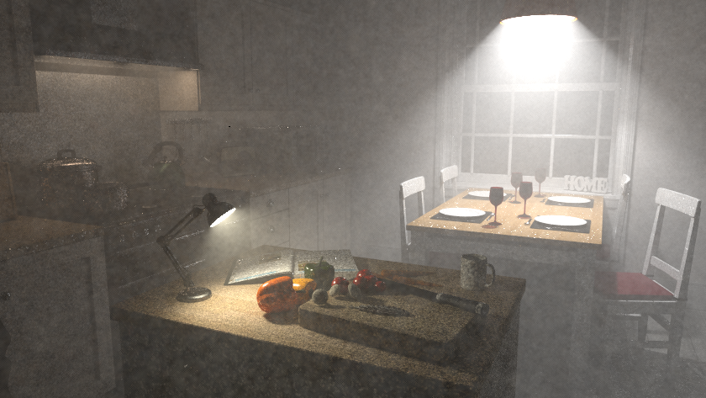



Traditional
Gradient-domain
Beam radiance estimate
relMSE: 0.0139
Gradient PT
relMSE: 0.0074
Beam radiance estimate
with denoiser
relMSE: 0.0035
Gradient beam radiance estimate
relMSE: 0.0037
Notes:
Beam radiance estimate is for rendering participating media. In fact, in this case, gradient-domain reconstruction works quite well and does not auxiliary buffers to have a result that is comparable to those from image denoisers.

Slide 21
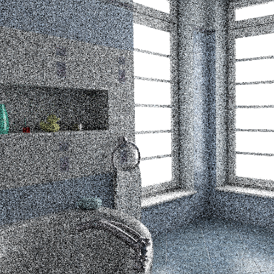
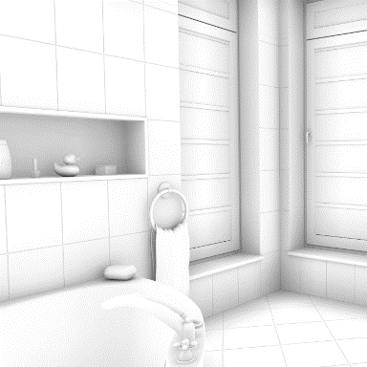
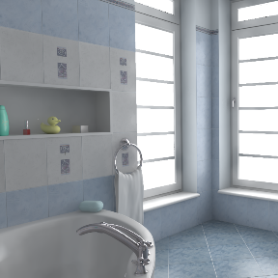
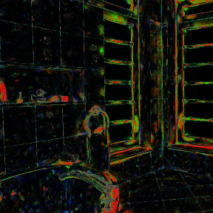

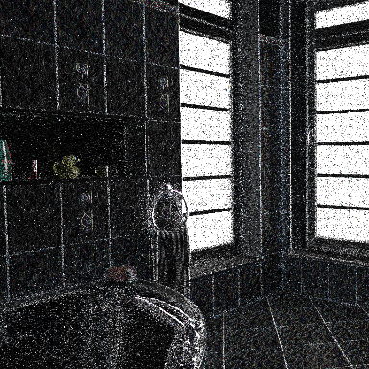
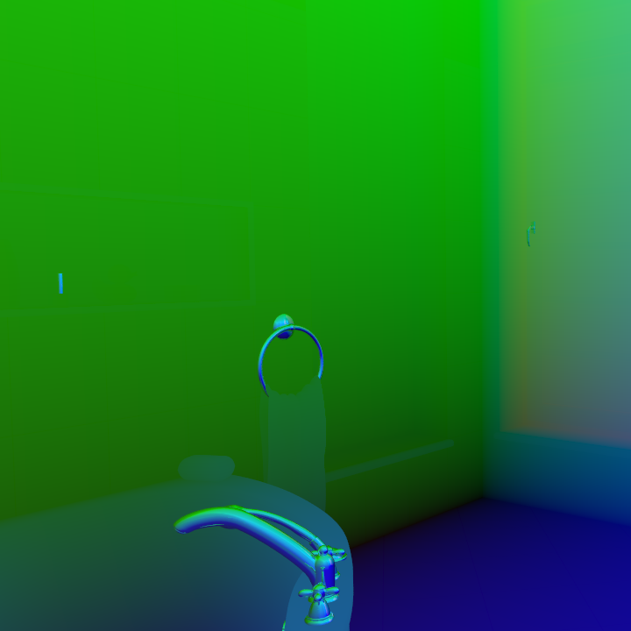

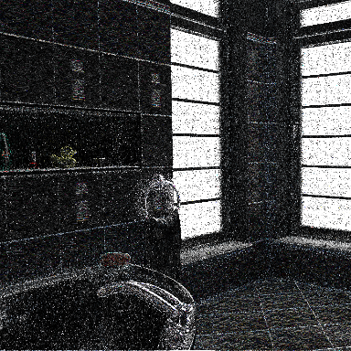
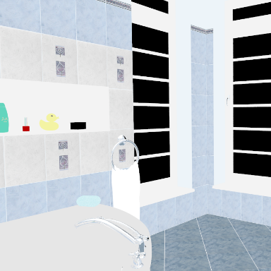

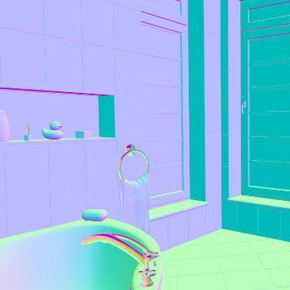
UTILIZING FEATURE BUFFERS
Regularizing Image Reconstruction for Gradient‐Domain Rendering with Feature Patches [Manzi et al. 2016]
Input: Base image, gradients and features
Candidate reconstructions
Selection map
Output
Different filter parameters
Error estimation
Notes:
Manzi et al. have explored this combination of gradient-domain and denoising techniques. The authors perform a constraint Poisson reconstruction based on the feature map information.
Their algorithms have different parameters that produce potentially different images with less or more bias. It is in general quite difficult to know in advance the optimal parameters. To address this, they perform the reconstruction with multiple parameter set and combines them using a selection map. This selection map picks the best technique in term of variance/bias pixelwise.

Slide 22
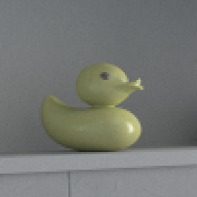
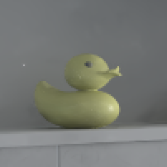
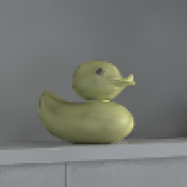
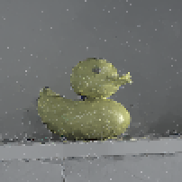
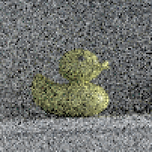
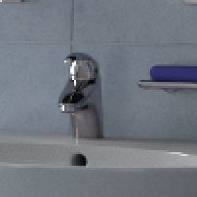
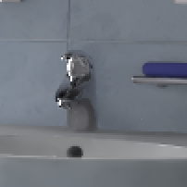
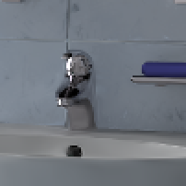
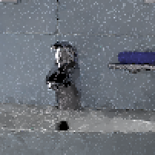
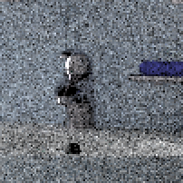
RESULTS
[Manzi et al. 2016]
Reference
Advance recons.
0.00126
PT + RDFC
(denoising)
0.00142
G-PT (L1)
0.00662
PT
0.05527
Notes:
The results shows that compared to denoising technique, this new technique can achieve better reconstruction. Moreover, this technique is able to remove the problematic fireflies in the L1 reconstruction.
However, the optimization was quite slow. Accelerating it will make it more useful in practice.

Slide 23
SUMMARY
Poisson reconstruction
Control variate reconstruction
Comparisons to image denoisers

