Slide 1
Gradient-domain
Light Transport Algorithms
Binh-Son Hua
The University of Tokyo
Notes:
Thank you Adrien for presenting the introduction and the fundamentals of gradient domain rendering. As we have learnt, two important tasks in gradient domain rendering is to sampling gradient efficiently and doing robust image reconstruction. In the next 45 minutes, I am going to talk about more advanced light transport algorithms for such two tasks.

Slide 2
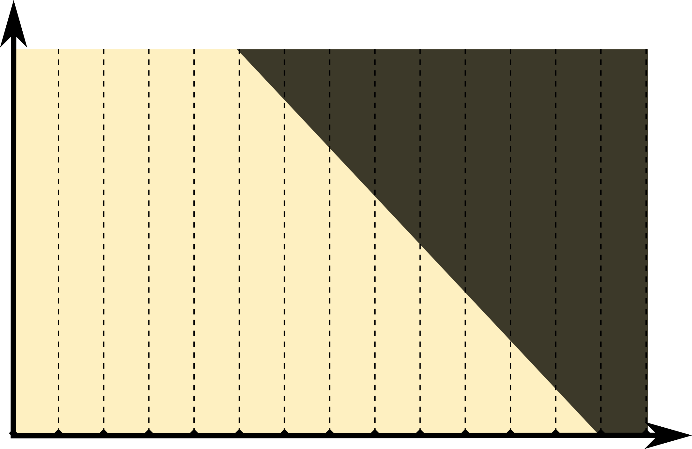


Sampling Gradients
Goal: to maximize sparsity, pair of paths needs to be as similar (correlated) as possible
Approach using shift mapping: first sample base path (-), then construct offset path (+) that is as similar as possible
$$p$$
In practice, high dimensional path space (p), many possible ways to implement shift
$$x$$
Notes:
Let us quickly recap gradient sampling.

Slide 3

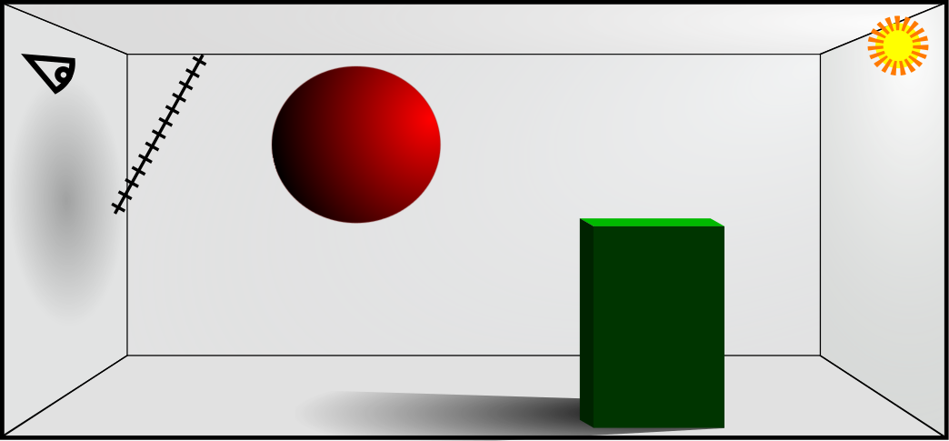

PATH RECONNECTION
Base Path
Diffuse
Offset Path
Light
Mirror
Notes:
Before we go on, we will need some vertex manipulation. Here we classify all path vertices as either specular, or diffuse, based on a threshold on the roughness of the BRDF.

Slide 4
PATH RECONNECTION
Base Path
Diffuse
Offset Path
Light
Mirror
Diffuse
Diffuse
Diffuse
Reusing path segments saves computation
Notes:
We distinguish between two cases:
(1) If both the current base and offset vertices, shown in blue here, are non-specular, and the next vertex of the base path, shown in yellow, is also non-specular, then we reconnect the offset path to the base path. After this, we let the offset path follow the base path until we reach the light.
This leads to paths that are as similar as possible. As a result, the throughput difference will be small, because the vertices where the paths differ are non-specular.
(2) However, for highly glossy materials, which we classify as specular, this direct reconnection strategy may not work well because the incoming and outgoing directions change when we reconnect, which might cause the BRDFs at the reconnection segment evaluated to zero.

Slide 5
HALF-VECTOR COPY
Base Path
Specular
Offset Path
Half-vector
Light
Mirror
Specular
Notes:
We address this issue by continuing to trace the offset path if we hit a vertex classified as specular.
Assume that we have shot this base path whose first vertex is at a specular surface. In this case, the offset path should have a similar BRDF value at the corresponding vertex.
We achieve this by copying the half-vector in local tangent coordinates, and this determines the direction of the next path segment.

Slide 6
HALF-VECTOR COPY + Reconnection
Base Path
Offset Path
Half-vector
Light
Mirror
Diffuse
Diffuse
Diffuse
Notes:
We continue by duplicating local half-vectors until we encounter two consecutive non-specular vertices in the base path, and the offset path is also sitting at a non-specular vertex. In this configuration we can safely reconnect to the base path.

Slide 7
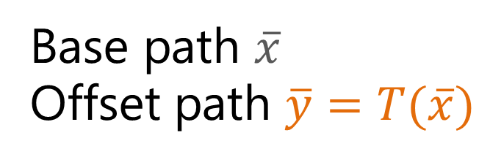
FORWARD and BACKWARD SHIFT
Base path $\overline{x}$
Offset path $\overline{y}=T(\overline{x})$
Notes:
… in this way where we got a path X and we shift this base path to the right pixel using the shift mapping operator.

Slide 8
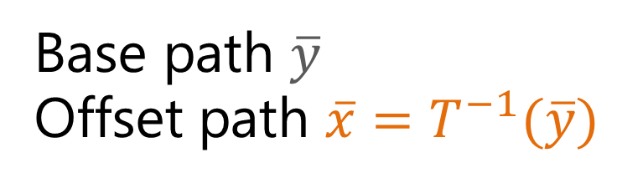
FORWARD and BACKWARD SHIFT
Base path $\overline{x}$
Offset path $\overline{y}=T(\overline{x})$
Base path $\overline{y}$
Offset path $\overline{x}=T^{−1}(\overline{y})$
Combine both gradient estimations with equal weights 0.5
Multiple importance sampling [Kettunen et al., 2015]
Notes:
However, this same pair of path can be generated in the opposite way.
As there are two way to generate this given path, we can combine them using multiple importance sampling. To evaluate the MIS weight we need to evaluate the pdf of the base and offset path.

Slide 9
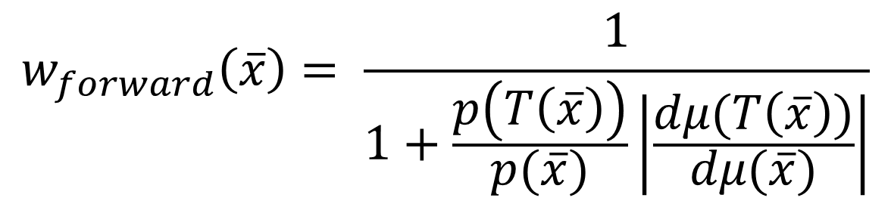
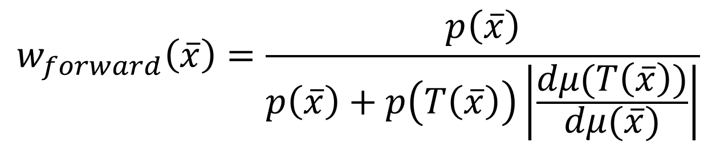
Multiple Importance sampling
$$w_{forward}\left(\overline{x}\right)=\frac{p\left(\overline{x}\right)}{p\left(\overline{x}\right)+p\left(T\left(\overline{x}\right)\right)\left|\frac{dμ(T\left(\overline{x}\right))}{dμ(\overline{x})}\right|}$$
Probability can be small
  Double precisions might be required
  Might to add epsilon on the denominator
  Rewrite the weight as a PDF ratio
$$w_{forward}\left(\overline{x}\right)= \frac{1}{1+\frac{p\left(T\left(\overline{x}\right)\right)}{p(\overline{x})}\left|\frac{dμ(T\left(\overline{x}\right))}{dμ(\overline{x})}\right|}$$
Notes:
However these probability can be small as its express the total probability to arrive to this particular vertex. So inside your practical implementation you want to avoid to have numerical instabilities. To reduce these instabilities, you can use double precision.
You can also add a small epsilon to the denominator. This will introduce a small be bias. But it is fine.
Finally, you can re-arranging the term inside the MIS weight and storing the ratios of the pdfs. This will mitigate the instability.

Slide 10
HANDLING SHIFT FAILS
1) Offset path fails to generate
2) Reversibility fails
Revert to finite difference on primal domain values by setting zero offset path contribution and MIS weight to 1.
Notes:
Other thing to be carefully with an implementation of gradient-domain is that a lot of times we have to deal with shift fail.
For example the shift mapping can failed due to visibility test or due to the fact that the shift is not reversible.
To handle shift fails, we need to revert back to the finite difference to estimate the gradients. Handling this change of estimator can be a bit complicated if you need to managed it manually.
So one trick is to simply return offset path contribution as zero with MIS weight as 1. By doing so, the code revert back to finite difference only when we have some shift mapping failure. This way simplify the implementation.
Note that in case of adaptive sampling, extra caution have to be done here as you need to proper normalize this gradient estimator. As the final gradient estimator will contain the gradient estimates using the shift mapping operator or finite difference.

Slide 11
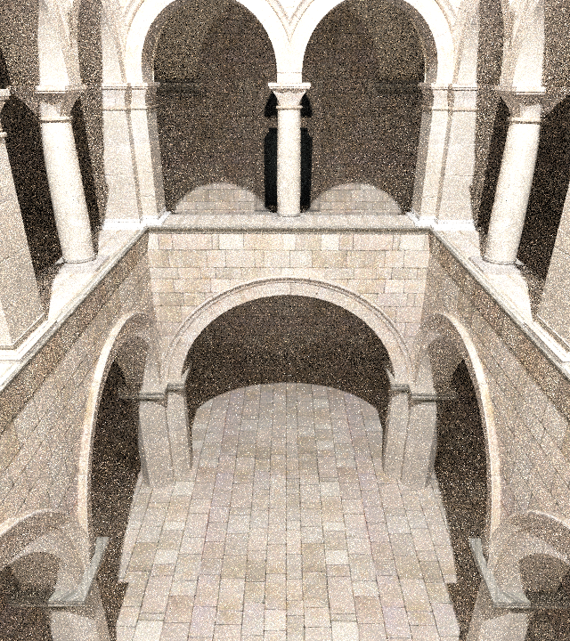
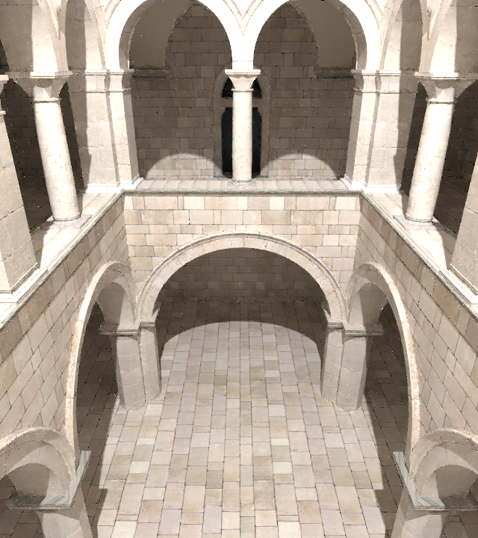
Gradient-domain
Path tracing
Path tracing, 8 spp

Slide 12
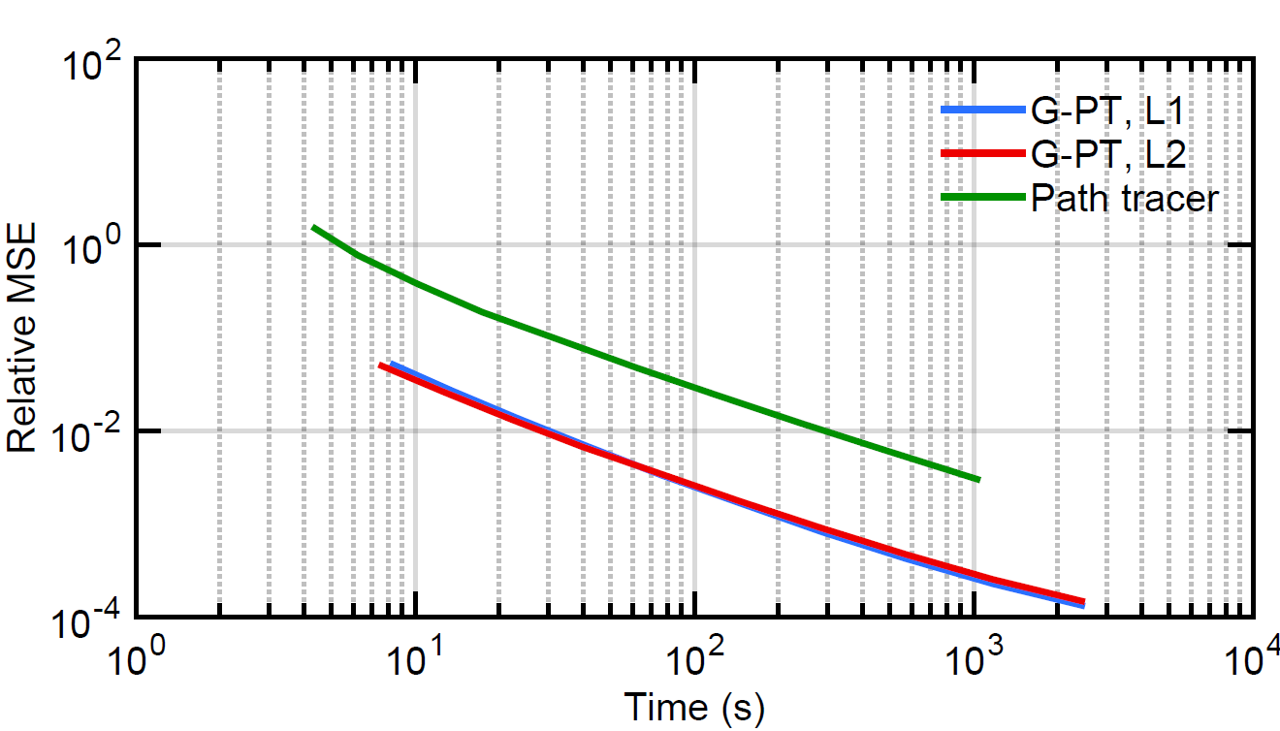
Error vs. Time (Sponza)
12x
Notes:
Plotting relative mean square error against time, we’re almost twelve times faster.

Slide 13
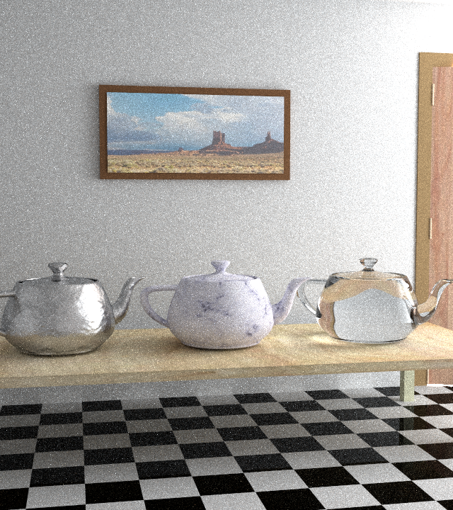

5x
Gradient-domain
Path tracing
Path tracing, 4096 spp
Notes:
The Door scene is designed to be hard for path tracing since all light comes from another room through the slightly opened door.
Here too we produce a significantly better image in equal time, despite the complexity of the light transport.
The speedup is roughly a factor of five.

Slide 14
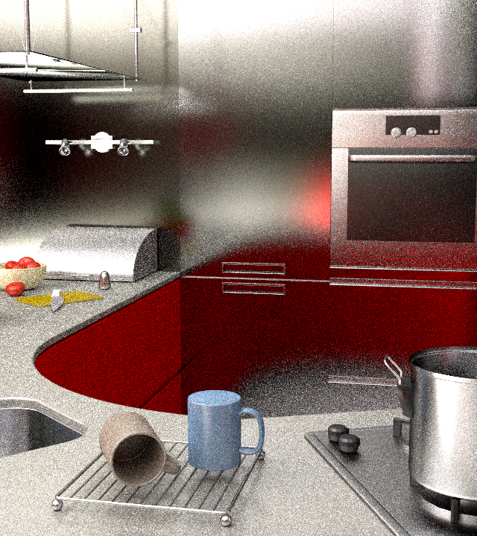

5x
Gradient-domain
Path tracing
Path tracing, 512 spp
Notes:
This Kitchen scene is very challenging for the gradient path tracer with its glossy surfaces lit by a small and hard to reach light source.
Still, we again outperform standard path tracing by a factor of five.

Slide 15
A BRIEF SUMMARY
Gradient-domain path tracing.
Path reconnection, half-vector copy shift mapping.
Multiple importance sampling.
Next: Gradient sampling in bidirectional light transport.
Notes:
We introduced gradient-domain path tracing, a relatively simple modification of standard path tracing that yields a significant benefit in image quality.
To see the reasons for its initially surprising efficiency, we also presented the first end-to-end frequency-domain analysis about gradient-domain rendering.
As for future work, we’d like to dynamically analyze the properties of the sampled signals to adaptively place more samples where they matter the most.
Also, we believe that many common methods could be improved by introducing gradient-domain versions of them. We will explore them in the next section.

Slide 16
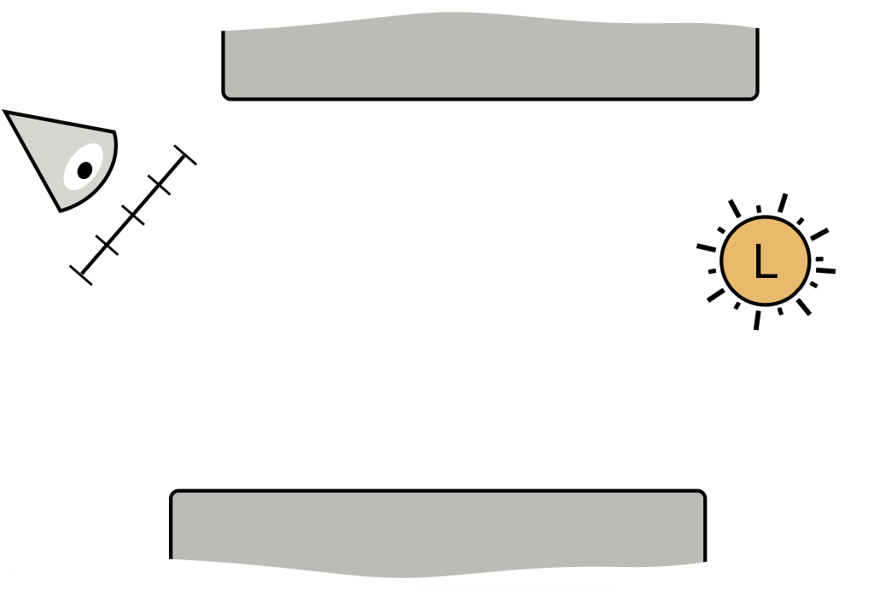
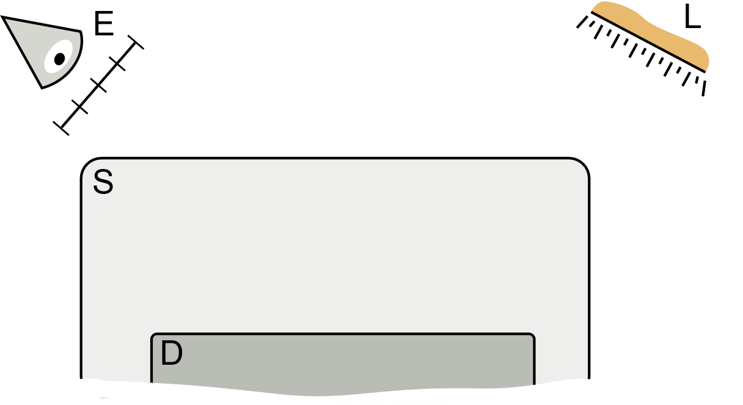
LIGHT TRANSPORT SIMULATION
Path tracing
Density estimation
Notes:
In the classical rendering, there is two main types of techniques.
The first one are path-based rendering approach that construct the path incrementally from the camera or the light by bouncing over the surfaces.
The second type of rendering technique is density-based rendering techniques which have two main steps:
First, several light path are generated from the light source and all their vertices are stored inside a spatial data structure.
Second, a path is generated from the camera and at some point there is a density estimation. The density estimation gathers all neighboring light paths and merge them to create complete light paths that connect from camera to light.

Slide 17
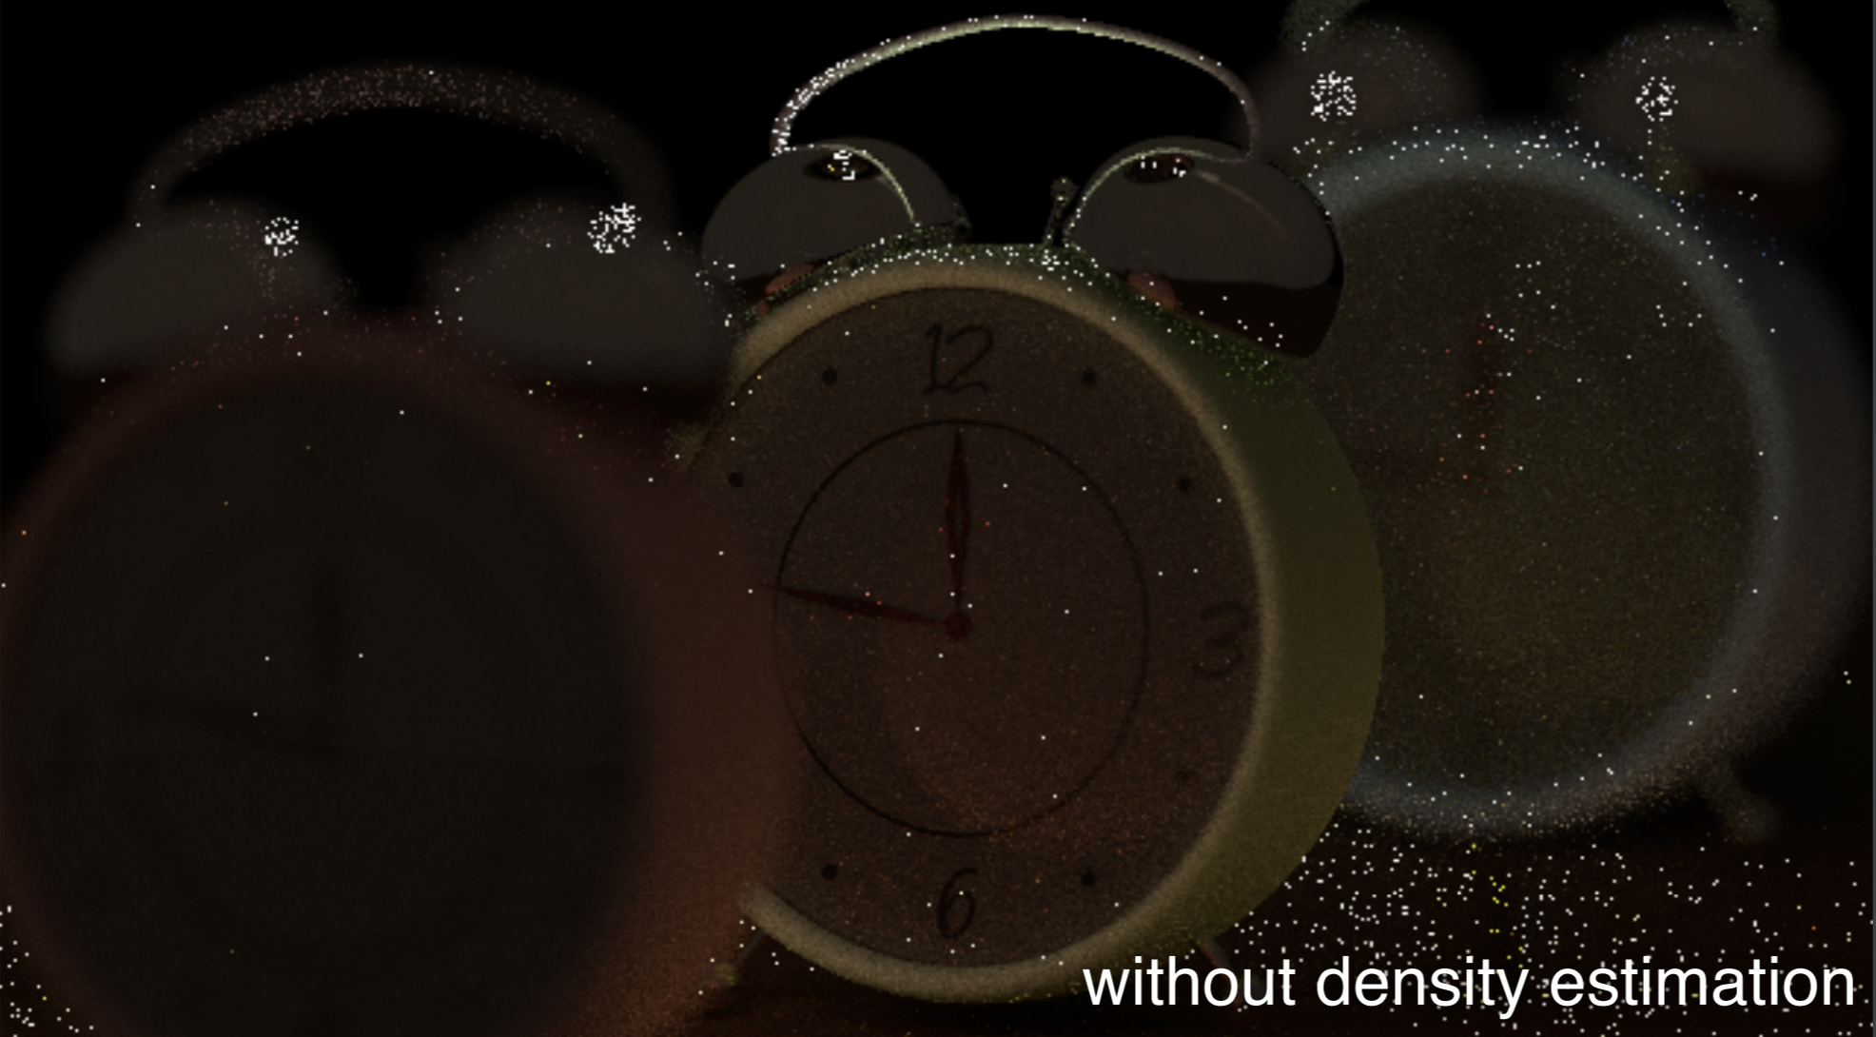
Path tracing

Slide 18
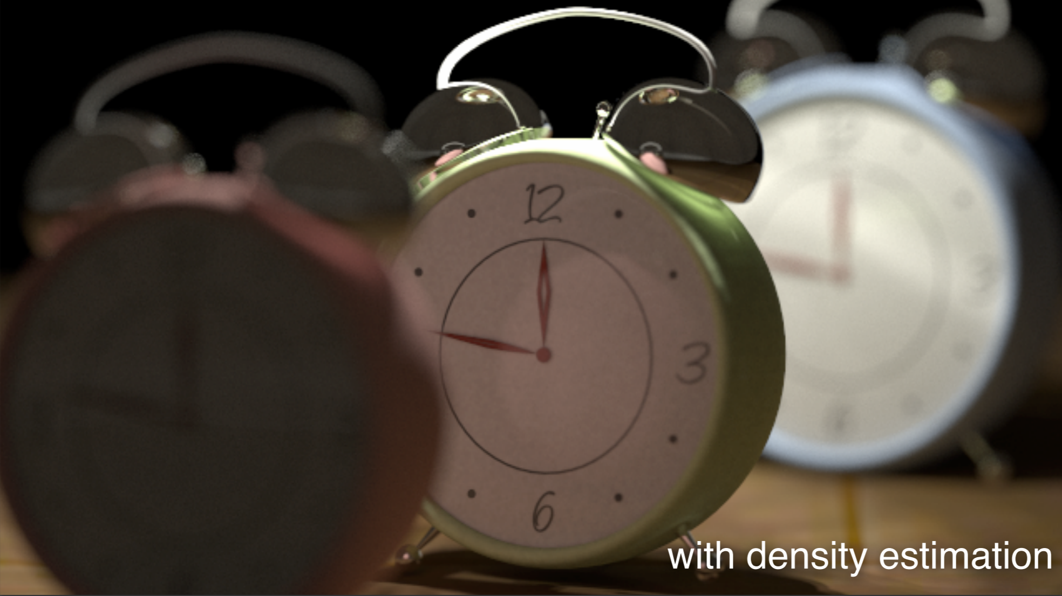
Density estimation [Hachisuka et al., 2009]
Notes:
Inspiring by the fact that photon density estimation is robust to such light transport: Stochastic Progressive Photon Mapping (SPPM) [Hachisuka et al., 2009] works really well here, our goal in this section is to improve the robustness of gradient-domain techniques using photon density estimation as the primal technique.

Slide 19
Gradient-domain
Photon Density Estimation

Slide 20
Photon DENSITY ESTIMATION
Two independent subpaths and a kernel to create a path
Notes:
Let’s recap how photon density estimation creates a complete path. We first trace two independent subpaths, one from the camera and one from the light. A density estimation kernel is centered at the last vertex on the camera subpath, and gather energy from the light subpath. The kernel transfers energy from y_s to z_t.
For gradient-domain rendering, we haven’t seen shift mapping for this type of path before. We need a mechanism to shift them.
Here we solve it using a hybrid shift mapping that has two steps.

Slide 21
GRADIENT-DOMAIN PHOTON DENSITY ESTIMATION
Two independent subpaths and a kernel to create a path
Hybrid shift mapping
[Hua et al., 2017]
Notes:
Let’s recap how photon density estimation creates a complete path. We first trace two independent subpaths, one from the camera and one from the light. A density estimation kernel is centered at the last vertex on the camera subpath, and gather energy from the light subpath. The kernel transfers energy from y_s to z_t.
For gradient-domain rendering, we haven’t seen shift mapping for this type of path before. We need a mechanism to shift them.
Here we solve it using a hybrid shift mapping that has two steps.

Slide 22
Shift the CAMERA path
Half-vector copy [Kettunen et al., 2015]
Notes:
The first step of our shift mapping is to shift the camera path. For clarity, we denote vertices starting from the camera on the camera subpath as from z_0 to z_t, and vertices starting from the light on the light subpath as from y_0 to y_s.
Note that similar to the final gathering step in photon mapping, when we generate the base camera path, if we encounter not enough smooth surface, we bounce over it until reach a diffuse surface.
Then generating the offset camera path is greatly similar to gradient-domain path tracing. The difference here is that we only bounce over not enough smooth surface until we hit a diffuse surface instead of a light. To determine the outgoing direction, we copy the local half vector from the base path. This scheme is simple and able to create coherent offset camera path.
After this first step, we have the offset camera path now. Let’s proceed to the next step.

Slide 23
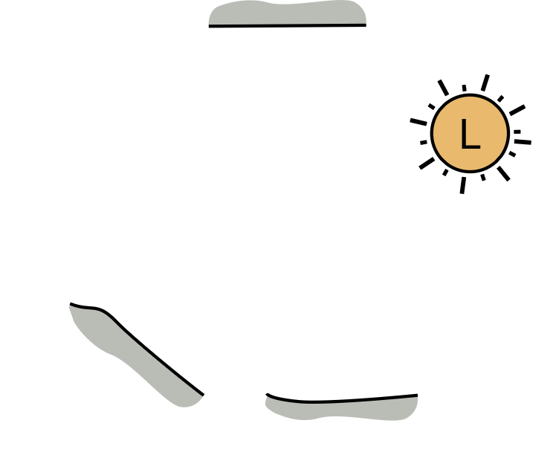





Shift THE photoN
$$y_{s−1}$$
$$z_{t}$$
$$y_{s}$$
$$z_{t}^{′}$$
$$y_{s}^{′}$$
Copy
Notes:
During the second step, we want to ensure the shift photon to lie inside photon density kernel.
To ensure that we maintain the relative position of the photon to the last vertex on the camera path in the shift. This determines the offset photon position.
However, as this procedure cannot ensure that the offset photon to lie on a surface, we trace an additional ray from the parent photon to project it to the nearest surface.

Slide 24
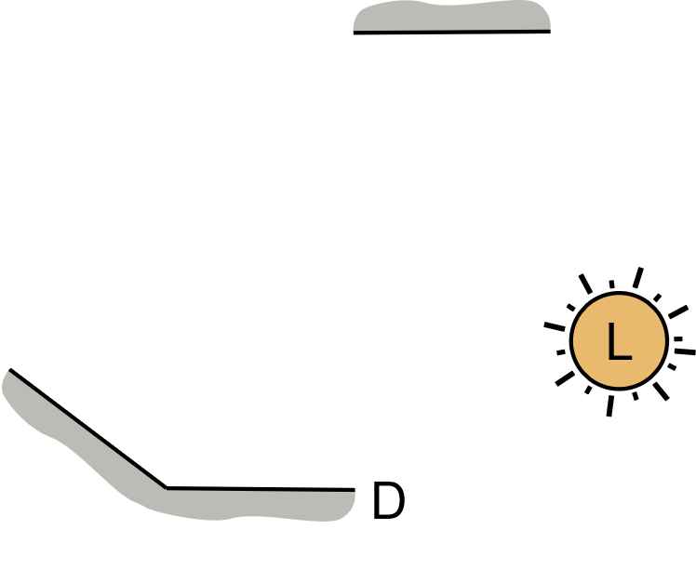



Shift the light path
Reconnection
$$y_{s−1}$$
D
$$z_{t}^{′}$$
$$y_{s}^{′}$$
Notes:
In this step, we have two cases.
The first case is when the parent photon is lying on a diffuse or mostly diffuse surface. In case, we can directly do a reconnection.
The second case is when the parent photon is on a specular or nearly specular surface. In this case, we have to construct a path between the offset photon location and the first diffuse parent, here denoted as y_b. These two points are our constraints and we can use manifold exploration [Jakob et al., 2012] to order to generate the vertices in between.

Slide 25
Shift the light path
Specular chain
$$y_{s−1}$$
S
$$z_{t}^{′}$$
$$y_{s}^{′}$$
Find a valid light path using manifold exploration [Jakob et al. 2012]
Notes:
In this step, we have two cases.
The first case is when the parent photon is lying on a diffuse or mostly diffuse surface. In case, we can directly do a reconnection.
The second case is when the parent photon is on a specular or nearly specular surface. In this case, we have to construct a path between the offset photon location and the first diffuse parent, here denoted as y_b. These two points are our constraints and we can use manifold exploration [Jakob et al., 2012] to order to generate the vertices in between.

Slide 26



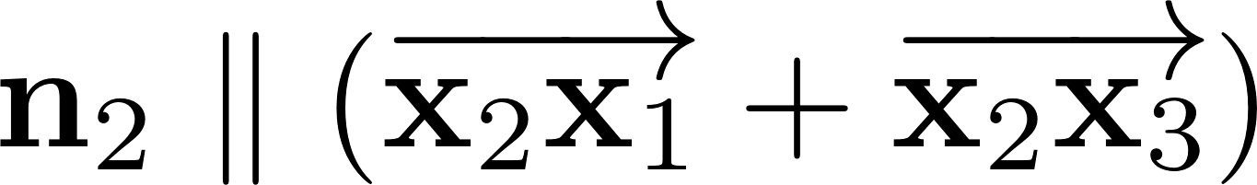
MANIFOLD EXPLORATION
D
D
S
Given and .
Specular reflection constraint

Slide 27
MANIFOLD EXPLORATION
D
D
Constraints represented by
a system of linear equations
S

Slide 28
MANIFOLD EXPLORATION
Use the derivative of the linear system
to search a valid offset path.
Half-vectors in the input and output
specular chain are preserved.

Slide 29
MANIFOLD EXPLORATION
Use the derivative of the linear system
to search a valid offset path.
Half-vectors in the input and output
specular chain are preserved.

Slide 30
MANIFOLD EXPLORATION
Use the derivative of the linear system
to search a valid offset path.
Half-vectors in the input and output
specular chain are preserved.

Slide 31
MANIFOLD EXPLORATION
Use the derivative of the linear system
to search a valid offset path.
Half-vectors in the input and output
specular chain are preserved.

Slide 32
MANIFOLD EXPLORATION
Specular chain
$$y_{s−1}$$
S
$$z_{t}^{′}$$
$$y_{s}^{′}$$
Details on Jacobian calculation [Jakob et al. 2012; Hua et al. 2017]
Notes:
In this step, we have two cases.
The first case is when the parent photon is lying on a diffuse or mostly diffuse surface. In case, we can directly do a reconnection.
The second case is when the parent photon is on a specular or nearly specular surface. In this case, we have to construct a path between the offset photon location and the first diffuse parent, here denoted as y_b. These two points are our constraints and we can use manifold exploration [Jakob et al., 2012] to order to generate the vertices in between.

Slide 33
HYBRID SHIFT MAPPING
Notes:
After these three steps, we have generated a pair of base and offset path for estimating the image-space gradients.

Slide 34
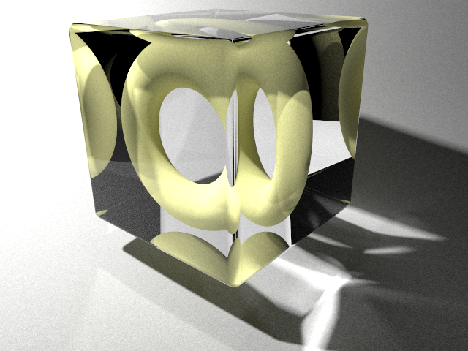



SPPM – 5 min
SPPM
Notes:
In comparison, as the scene have a lot of SDS path, SPPM handles them quite well despite some uniform noise in the image.

Slide 35




G-PM – 5 min
SPPM
G-PM
Notes:
G-PM makes it possible to remove all the noise in the SDS path and direct path (second and third column).
However, for the difficult caustic (first column), the noise is slightly higher as here the light path are complicated and manifold exploration failed to generate the correct offset light path. The results is slightly worse than classical SPPM in this region.

Slide 36




Reference
SPPM
G-PM
Reference
Notes:
Despite that, G-PM is still the closest to the reference.

Slide 37
relMSE
Time (s) 60 300 1800
Time
SPPM
G-PM
Notes:
In terms of convergence, G-PM still improves over SPPM.

Slide 38
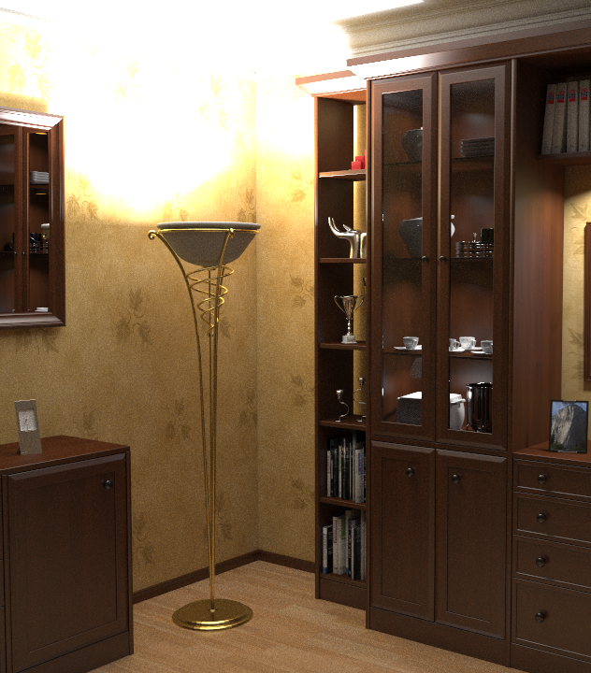






Limitations
Gather photon on glossy surfaces
SPPM
G-PM
G-BDPT
Notes:
A limitation of G-PM is that it is not efficient in handling glossy surfaces. A possible solution is to add more bidirectional path sampling techniques, resulting in gradient bidirectional path tracing (G-BDPT).

Slide 39
Gradient-domain
Bidirectional Path Tracing

Slide 40
Bidirectional path tracing
[Lafortune et al., 1993, Veach et al., 1994]
Notes:
Now that we have the fundamentals of gradient-rendering, let us recap BDPT:
BDPT first traces two subpaths, one from the eye and one from the light, and both may be incomplete. By connecting these subpaths we can generate complete light paths. Connections can be done between arbitrary pairs of vertices and hence a large amount of paths can be generated from two subpaths.
Note that the overhead per connected path is only one additional ray that must be traced which makes this way of sampling very efficient.
Note that some of the connected paths directly connect to the eye and intersect the image plane at a different position. Therefore they may contribute to different pixels in the image.

Slide 41
Gradient-domain BDPT
Shift all paths, one by one?
Too expensive!
Notes:
When combining this with gradient-domain rendering, the first question that arises is how to compute gradients of such a set of paths, since path-samples are not generated individually anymore.
The simplest way is to generate a gradient sample for each connected path by creating a offset path individually for each connection strategy. This is however prohibitively expensive since the number of connected paths grows quadratically with the number of vertices in the subpaths.

Slide 42
Reuse PATH SEGMENTS
Reuse path segment!
Notes:
So we need to think about this can be done more efficiently. We need to think about whether there are parts of such shifted paths that can be reused between the different connected paths. In order to simplify the problem, let us look at subsets of the whole set separately.
For now, let’s assume a diffuse scene.
First, let us look at connection paths that connect to the second or later vertex of the eye path. In this example we have only two such paths, but again note that in more realistic setups we have much more strategies.
Here the upper path has this offset path. And the lower path has a different offset path.
If we compare both offset paths we see that the parts of the shift that aren’t equal to the base path, are actually the same for both connection paths. We can therefore compute this shared part of the offset path once and reuse it for all such connection strategies.

Slide 43
Reuse AND RETRACE
Retrace path segment!
Reuse path segment!
Notes:
Let us now look at connection paths that connect to the primary vertex of the eye path.
Here again let us first look at the offset path of the base path at the top, and now at the offset path of the base path at the bottom.
There we see that only the primary ray of the offset path is shared for these paths. The ray that reconnects to the base path must be computed for each such strategy separately.

Slide 44
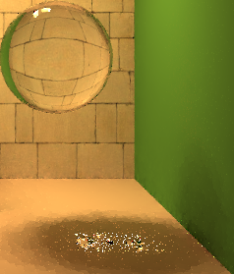
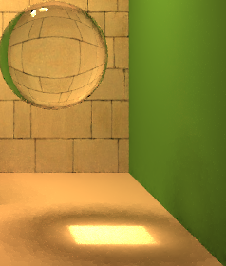
LIGHT TRACING PATHS
Without
With
Notes:
The last subset of the paths that we look at are light tracing paths; These are stategies that connect directly to the eye. This type of paths is important to compute caustics and therefore we also want to compute gradient samples for them.
Since the base paths of light tracing paths contribute to different pixels, their offset paths might be completely different from each other, therefore we must compute the entire offsetpath for each light tracing path from scratch! This is not very efficient, but since only a small fraction of all connection strategies are light tracing paths, this is still affordable.
As a sidenote: Our explanations are only valid for diffuse paths, as soon as specularity comes into play, the efficient gradient sampling becomes slightly more complicated. In general, we have to employ manifold exploration [Jakob et al., 2012] for generating the offset path.

Slide 45
SCENE WITH SPECULAR OBJECTS
Light
Mirror

Slide 46
SCENE WITH SPECULAR OBJECTS
Only diffuse-diffuse vertex connection.
From camera, the offset path joins the base path at the 2nd diffuse vertex.

Slide 47
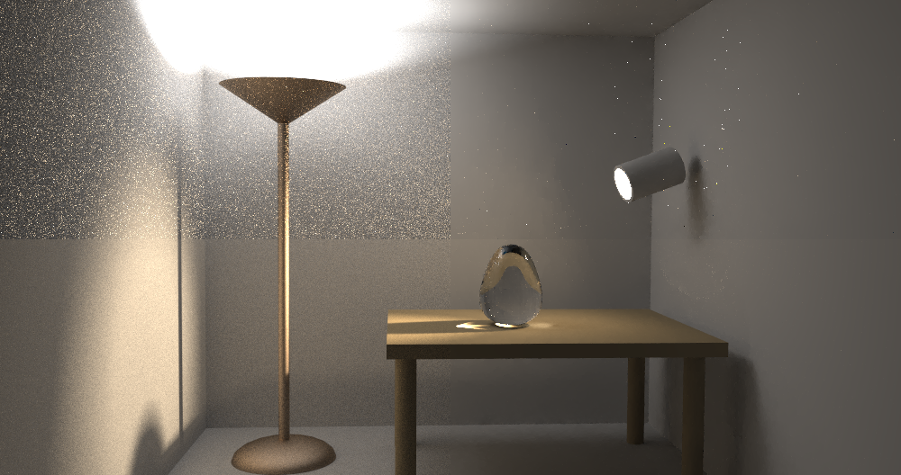
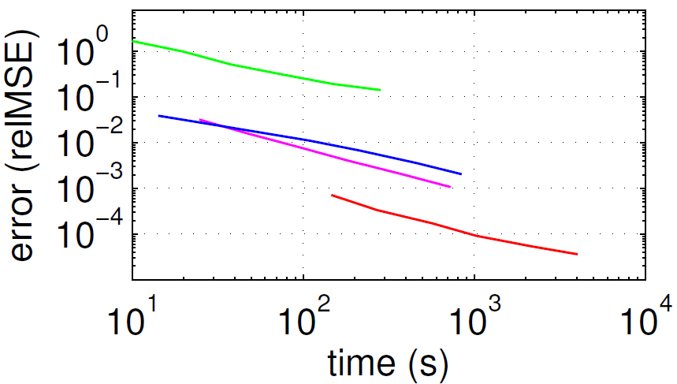
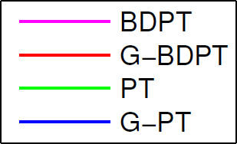


RESULTS
PT, 3mins
G-PT, 3mins
x10
x5
BDPT, 3mins
G-BDPT, 3mins
Notes:
Another example is to compare PT and BDPT with and without gradient-domain rendering in a simple scene with caustics and indirect illumination.
With PT the scene is resolved very badly and suffers from extensive noise because next event estimation fails most of the time.
G-PT successfully removes most noise coming from diffuse interreflections, but fails at removing noise from caustics, which are seen as bright outlies in the image. BDPT is much better for rendering this scene because it can connect more often to the light source and resolve caustics better, but still not as good in denoising diffuse interreflections as G-PT.
By contrast, G-BDPT has similar denoising functionality as G-PT but also succeeds at denoising caustics.
Looking at convergence plots for this scene with compared relMSE over time, we see that at equal time G-PT outperforms PT by a factor of 10, but is similar in terms of quality as BDPT. G-BDPT now improves upon BDPT again by a factor of 5.
In general G-BDPT directly outperforms G-PT in scenes where the underlying BDPT sampler is better than PT.

Slide 48
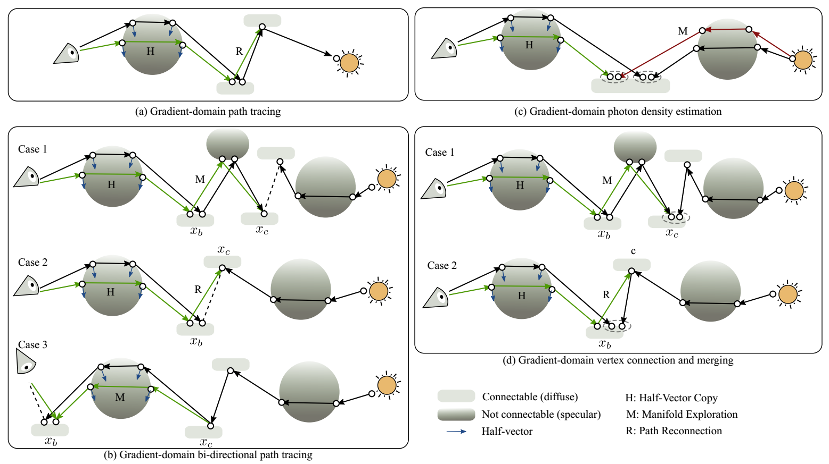
GRADIENT-DOMAIN
LIGHT TRANSPORT

Slide 49
GRADIENT-DOMAIN
LIGHT TRANSPORT

Slide 50
GRADIENT-DOMAIN
LIGHT TRANSPORT

Slide 51
GRADIENT-DOMAIN
LIGHT TRANSPORT

Slide 52
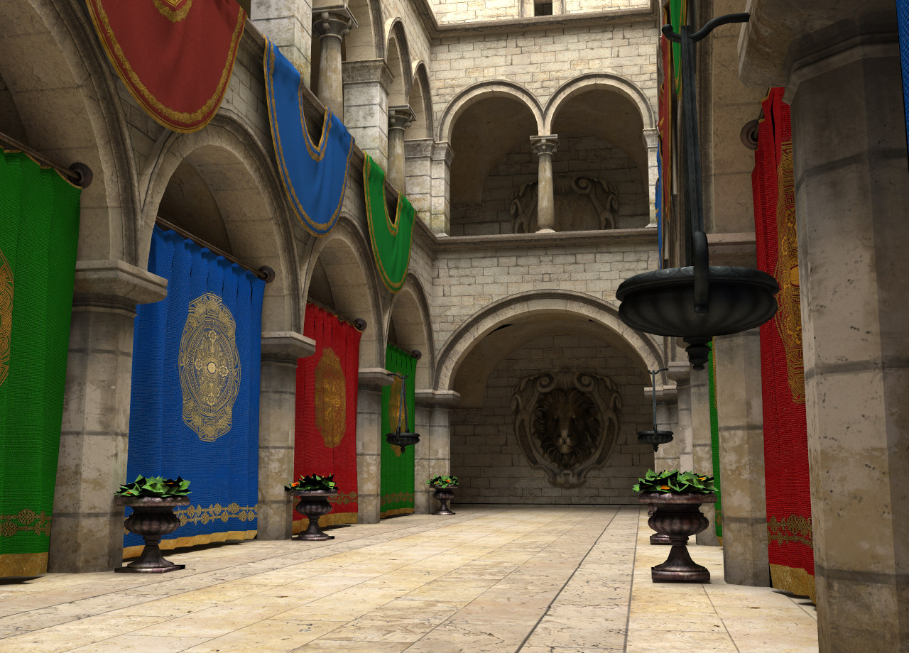

Slide 53
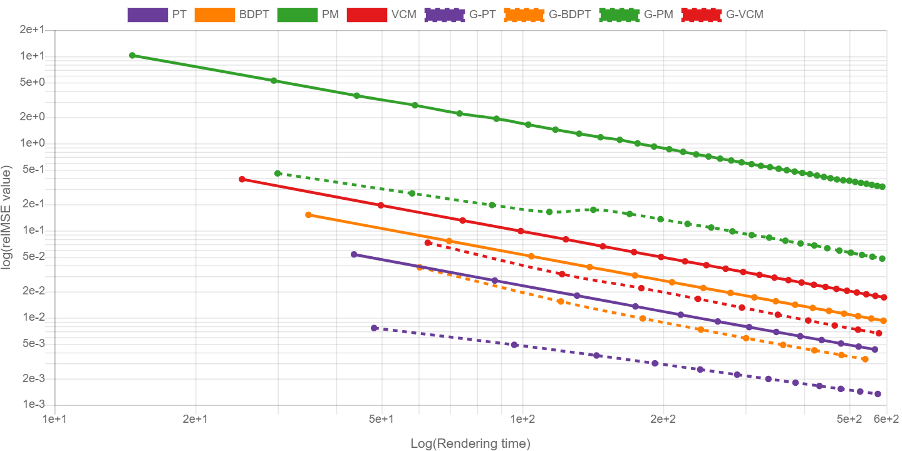
SPONZA SCENE

Slide 54
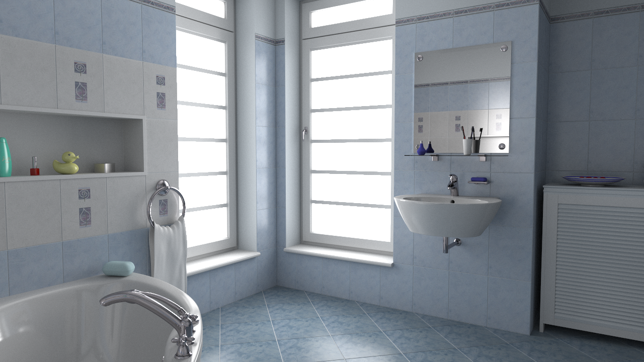

Slide 55
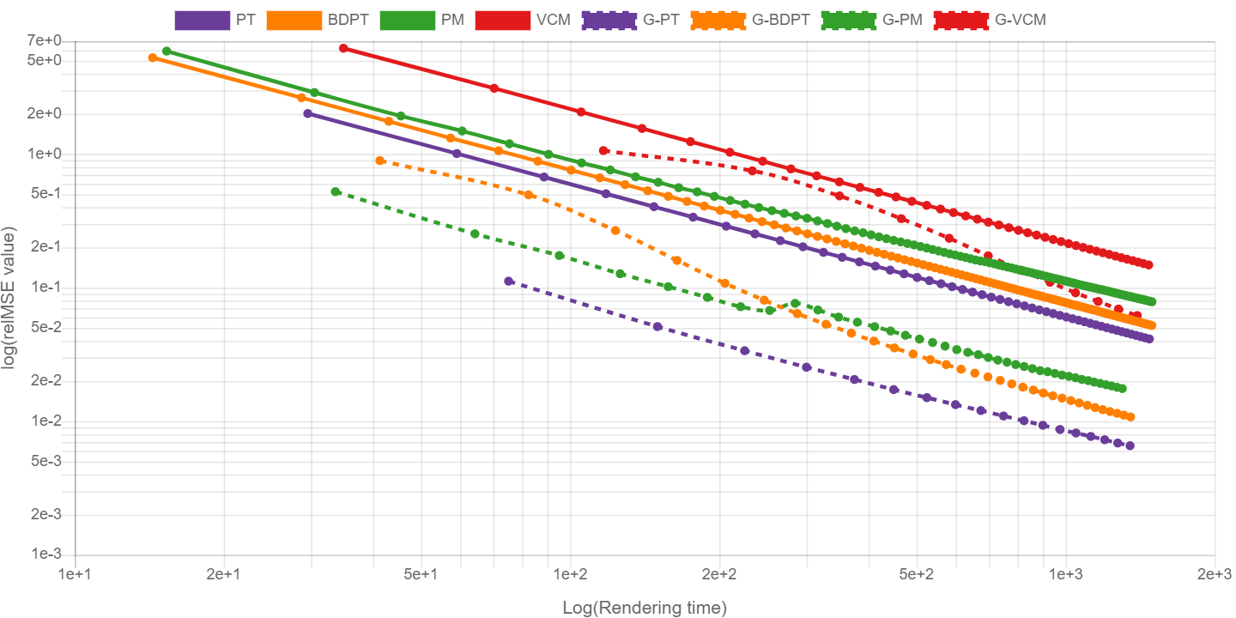
BATHROOM SCENE

Slide 56
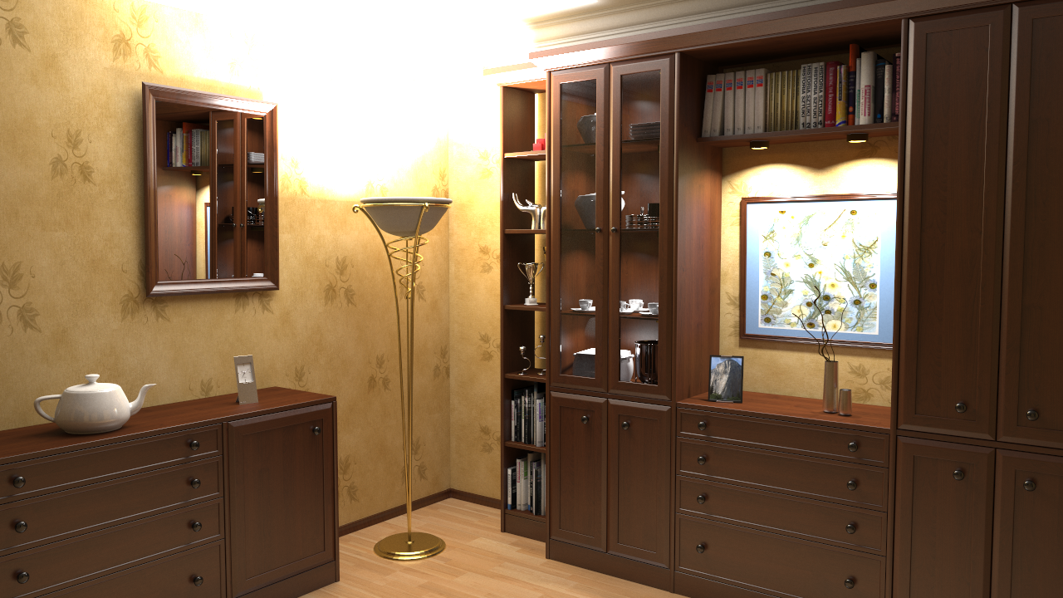

Slide 57
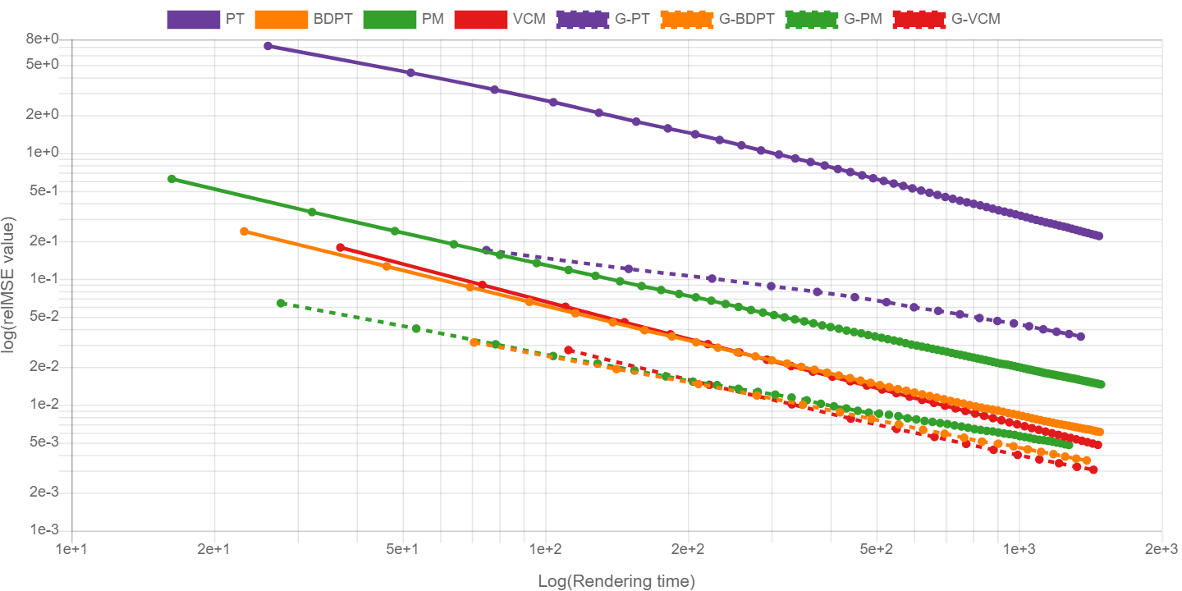
BOOKSHELF SCENE

Slide 59
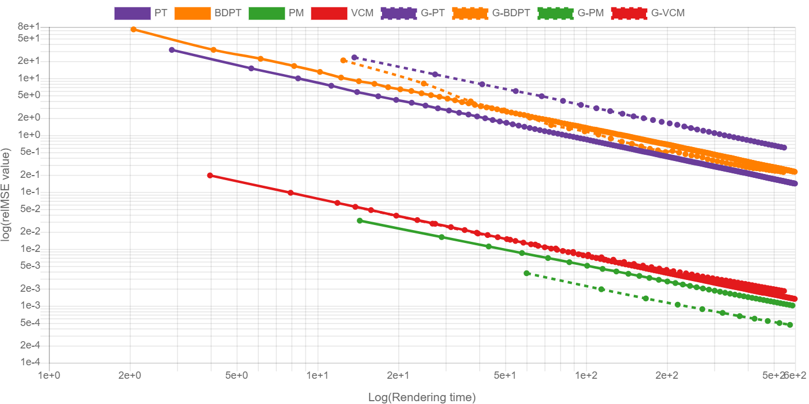
TORUS SCENE

Slide 60
SUMMARY
Gradient-domain light transport
Uni-, Bi-directional path tracing
Photon density estimation
Unified path sampling / vertex connection and merging
improves upon traditional light transport.
Shift mapping: random sequence, half-vector copy, reconnection, manifold exploration.
No best gradient-domain algorithm so far.
Notes:
In this section, we explored two bidirectional light transport algorithms for gradient-domain rendering: bidirectional path tracing and photon density estimation. A combination of them is also possible with gradient-domain vertex connection and merging.
We show that adding gradient estimation and image reconstruction to such algorithms show a boost in convergence.

Slide 61
Appendix

Slide 62
SCENE WITH SPECULAR OBJECTS
Light
Mirror
Diffuse

Slide 63
SCENE WITH SPECULAR OBJECTS
Base Path
Offset Path
Light
Mirror
Diffuse

Slide 64
SCENE WITH SPECULAR OBJECTS
Base Path
Offset Path
Light
Mirror
Diffuse

Slide 65
SCENE WITH SPECULAR OBJECTS
Base Path
Offset Path
Light
Mirror
Diffuse

Slide 66
SHIFt A SPECULAR CHAIN?
Base Path
Offset Path
Light
Mirror
Specular
Diffuse

Slide 67
MANIFOLD EXPLORATION
Light
Mirror
Specular
Diffuse
[Jakob et al., 2012]

