Slide 1
Fundamentals of
Gradient-domain Light Transport
Adrien Gruson
McGill University

Slide 2
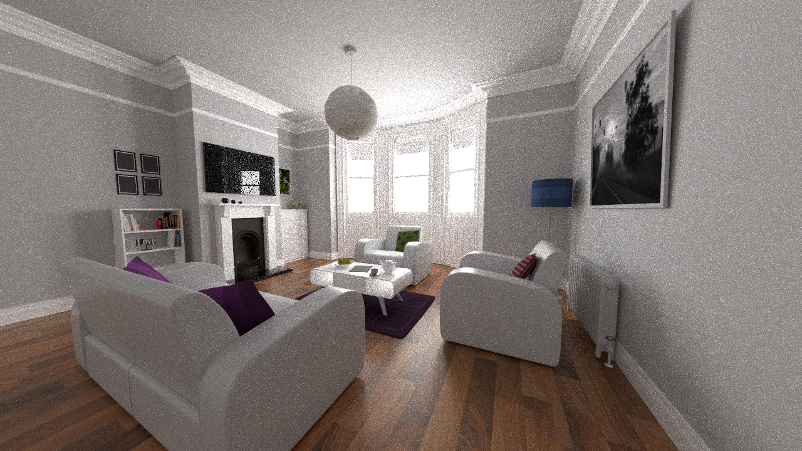
Path tracing (2 min)

Slide 3
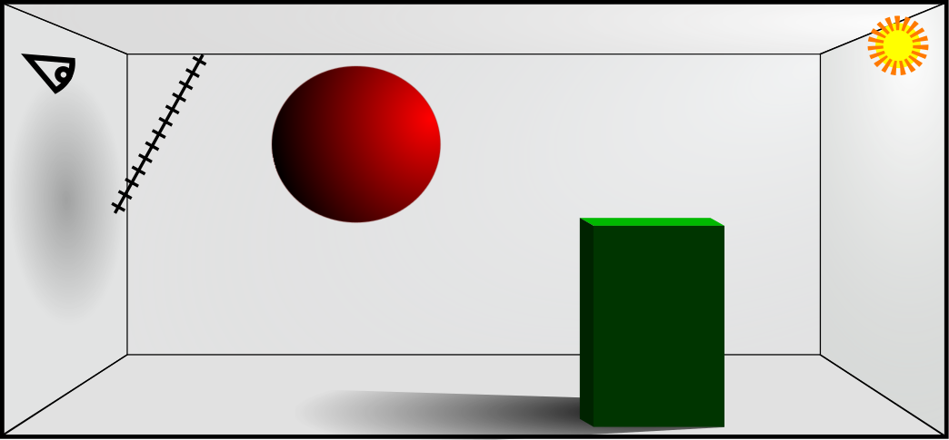

Rendering equation
Light
Mirror

Slide 4
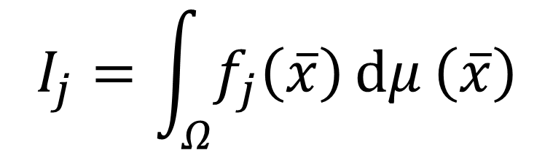
Rendering equation
Mirror
Light
$$I_{j}=\int_{Ω}{f_{j}\left(\overline{x}\right)ⅆμ}\left(\overline{x}\right)$$
[Veach 98]

Slide 5
Rendering equation
Mirror
Light
$$I_{j}=\int_{Ω}{f_{j}\left(\overline{x}\right)ⅆμ}\left(\overline{x}\right)$$
[Veach 98]

Slide 6
Rendering equation
Mirror
Light
$$I_{j}=\int_{Ω}{f_{j}\left(\overline{x}\right)ⅆμ}\left(\overline{x}\right)$$
[Veach 98]

Slide 7



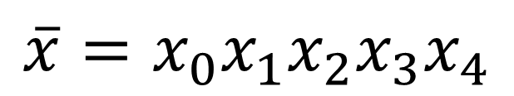
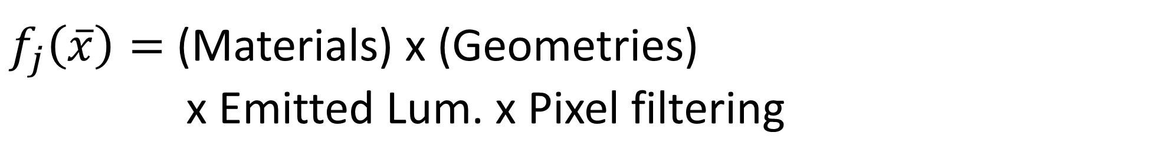


Rendering equation
$$\overline{x}=x_{0}x_{1}x_{2}x_{3}x_{4}$$
$$x_{4}$$
$$x_{2}$$
Mirror
Light
$$x_{0}$$
$$I_{j}=\int_{Ω}{f_{j}\left(\overline{x}\right)ⅆμ}\left(\overline{x}\right)$$
$$x_{3}$$
$$x_{1}$$
$f_{j}\left(\overline{x}\right)=$ (Materials) x (Geometries)
x Emitted Lum. x Pixel filtering
[Veach 98]

Slide 8
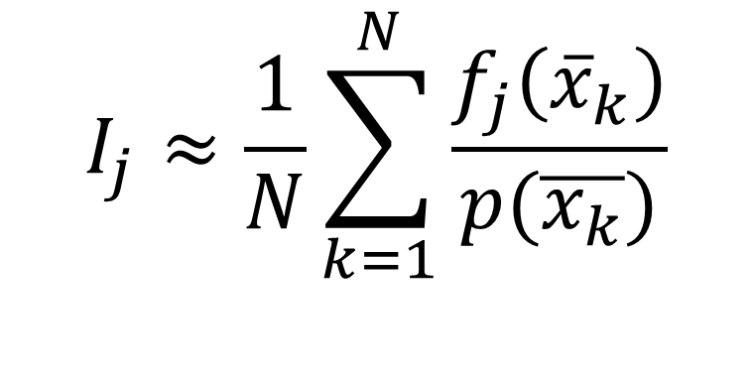
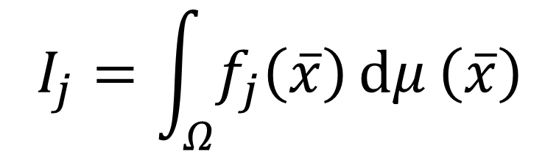
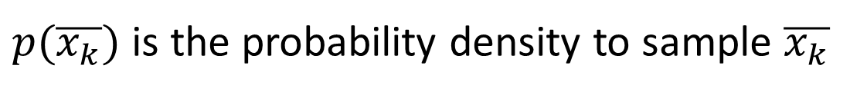
Rendering equation
Monte Carlo estimator
$$I_{j}≈\frac{1}{N}\sum_{k=1}^{N}{\frac{f_{j}\left({\overline{x}}_{k}\right)}{p(\overline{x_{k}})}}$$
$$I_{j}=\int_{Ω}{f_{j}\left(\overline{x}\right)ⅆμ}\left(\overline{x}\right)$$
$p(\overline{x_{k}})$ is the probability density to sample $\overline{x_{k}}$

Slide 9

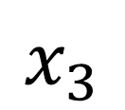
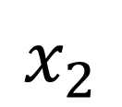
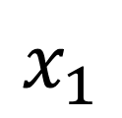
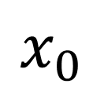
Path tracing
$$x_{2}$$
$$x_{3}$$
$$I_{j}$$
$$x_{0}$$
$$x_{1}$$

Slide 10
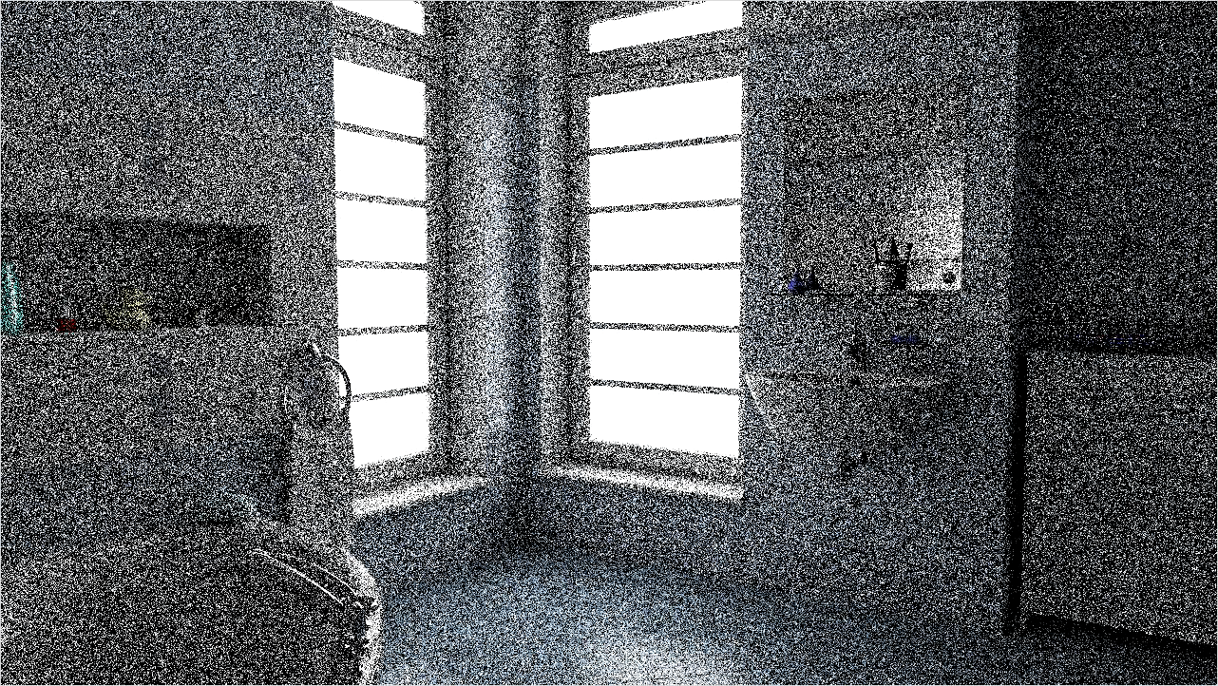
Motivation
error / 2 = samples * 4
15min
30min
45min
1h

Slide 11
Motivation
Observation
Noise mostly proportional to signal magnitude
Idea
Noise reduction by sampling sparse signal representation
  Sparse: signal magnitude low, except in small regions
  Wavelets, edge filters, gradients, etc.
  Theoretical justification: Kettunen et al. SIGGRAPH 2015

Slide 12
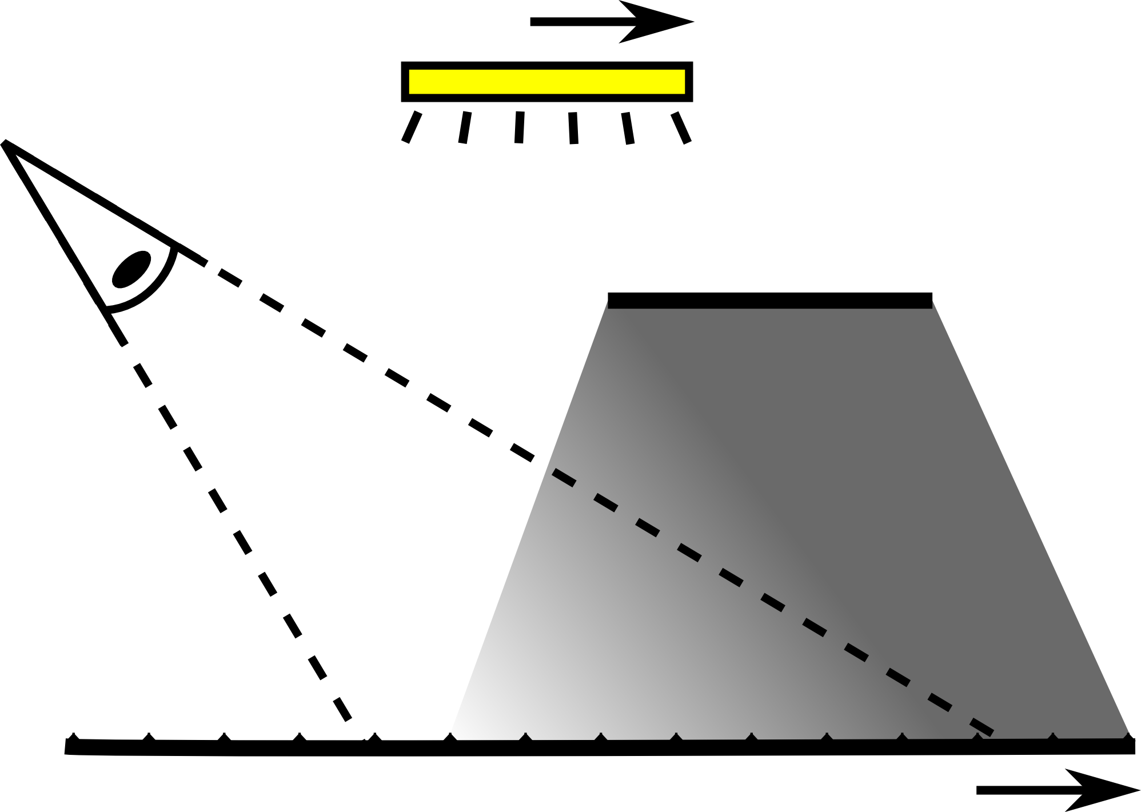


light
$$p$$
camera
occluder
receiving surface
$$x$$

Slide 13
Scene
light
$$p$$
camera
occluder
receiving surface
$$x$$

Slide 14
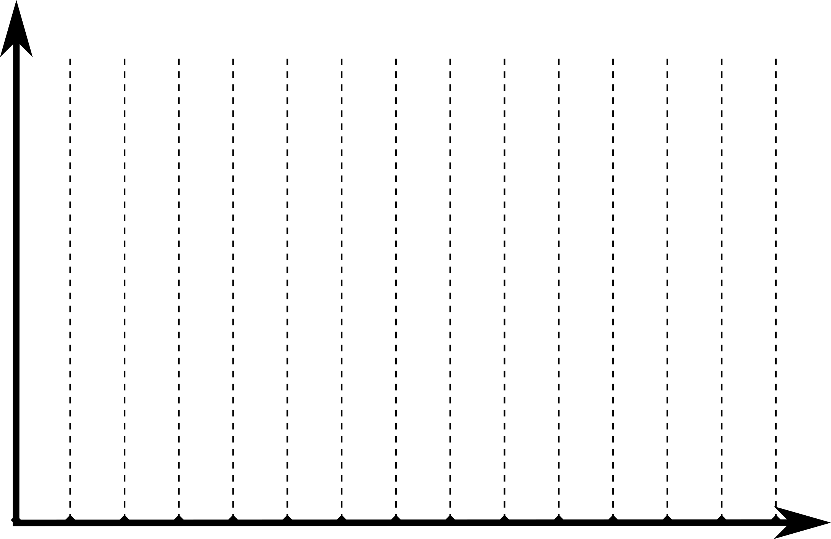
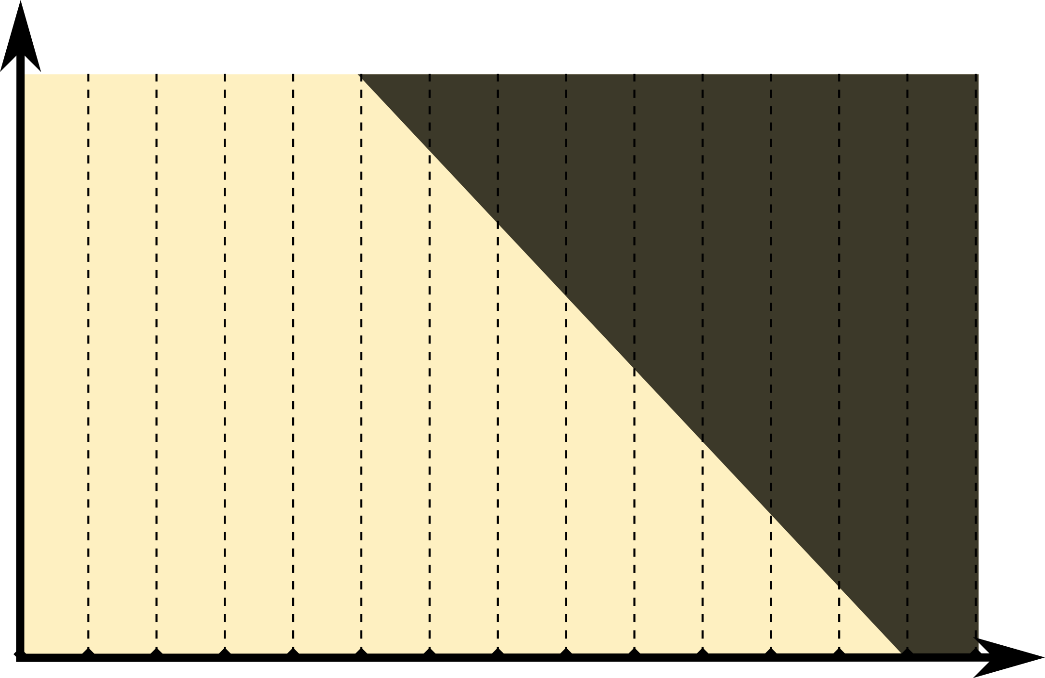








Scene
Path Space
$$\text{Light} \text{positions}$$
$$\text{Light} \text{positions} p$$
$$p$$
$$p$$
$$x$$
$$x$$
$$\text{Pixels}$$
$$\text{Pixels} x$$

Slide 15


Scene
Path Space
$$p$$
∫
$$x$$

Slide 16


$$p$$
Path Tracing
[Kajiya1986]
Gradient PT
+
$$x$$

Slide 17


$$p$$
Gradient-domain path tracing
Sparsity: gradients small
except in red region
$$x$$
Path space differences between pixels (”gradients”)

Slide 18
$$p$$
Gradient-domain path tracing
Gradient
magnitude zero,
no variance
$$x$$
Path space differences between pixels (”gradients”)
Notes:
Even though Metropolis methods are efficient for complex illumination, they suffer from unpredictable convergence. Path tracing, on the other hand, converges predictably and is easy to implement.
... The success of Gradient-Domain Metropolis <c>inspired us to investigate gradient sampling for regular path tracing. We show, that, maybe surprisingly, we can benefit from gradient sampling also in standard path tracing, even without changing sample distributions.<c>
... ... ...
A gradient domain path tracer is actually rather easy to implement, and I will next describe the main components of the algorithm.
***** 3:44 / -14:16 *****

Slide 19

Gradients on 2D image plane
Four finite difference
samples per pixel

Slide 20
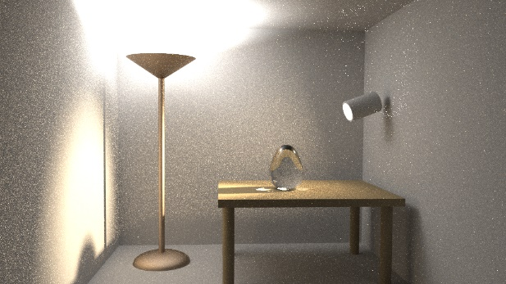
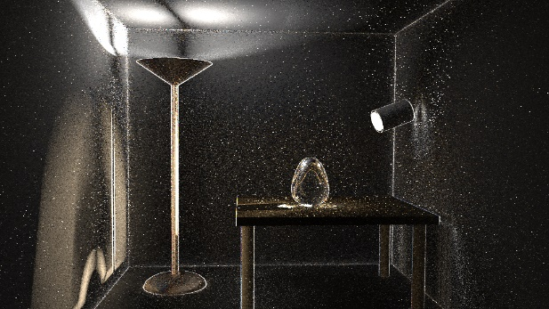
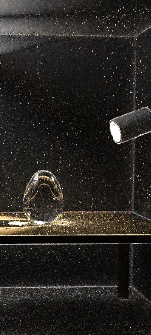
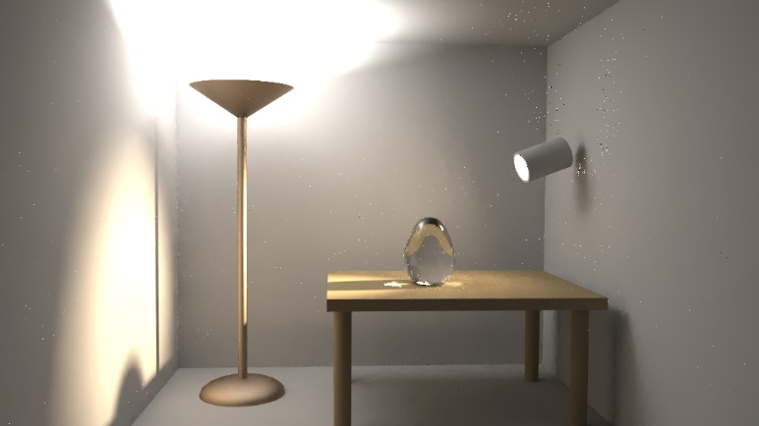
THE BASIC ALGORITHM
1. Perform standard Monte Carlo rendering to obtain primal image
2. Sample gradients: horizontal and vertical
3. Reconstruct image from primal and gradients

Slide 21

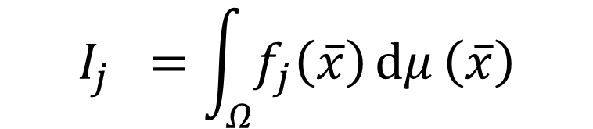
Gradient RENDERING INTEGRAL
$$j$$
$$I_{j} =\int_{Ω}{f_{j}\left(\overline{x}\right)ⅆμ}\left(\overline{x}\right)$$
Primal

Slide 22
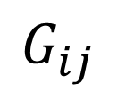
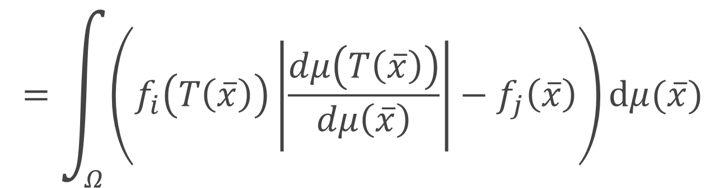


Gradient RENDERING INTEGRAL
$$j$$
$$I_{j} =\int_{Ω}{f_{j}\left(\overline{x}\right)ⅆμ}\left(\overline{x}\right)$$
Primal
$$j$$
$$i$$
-
+
$$G_{ij}$$
$$=\int_{Ω}{\left(f_{i}\left(T\left(\overline{x}\right)\right)\left|\frac{dμ\left(T\left(\overline{x}\right)\right)}{dμ\left(\overline{x}\right)}\right|−f_{j}\left(\overline{x}\right)\right)ⅆμ(\overline{x})}$$
Gradient

Slide 23



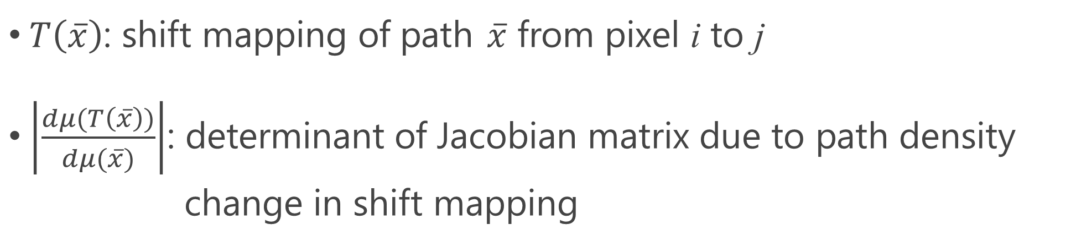
Gradient RENDERING INTEGRAL
$$G_{ij}=\int_{Ω}{\left(f_{i}\left(T\left(\overline{x}\right)\right)\left|\frac{dμ\left(T\left(\overline{x}\right)\right)}{dμ\left(\overline{x}\right)}\right|−f_{j}\left(\overline{x}\right)\right)dμ(\overline{x})}$$
Offset path contribution
Base path contribution
$$\overline{x}$$
$$T(\overline{x})$$
$T\left(\overline{x}\right)$: shift mapping of path $\overline{x}$ from pixel i to j
$\left|\frac{dμ(T\left(\overline{x}\right))}{dμ(\overline{x})}\right|$: determinant of Jacobian matrix due to path density
change in shift mapping
j
i

Slide 24


Gradient RENDERING INTEGRAL
$$G_{ij}≈\frac{1}{N}\sum_{k=1}^{N}{\frac{f_{i}\left(T\left(\overline{x_{k}}\right)\right)\left|\frac{dμ\left(T\left(\overline{x_{k}}\right)\right)}{dμ\left(\overline{x_{k}}\right)}\right|−f_{j}\left(\overline{x_{k}}\right)}{p(\overline{x_{k})}}}$$
Defining a good $T\left(\overline{x_{k}}\right)$ is essential

Slide 25
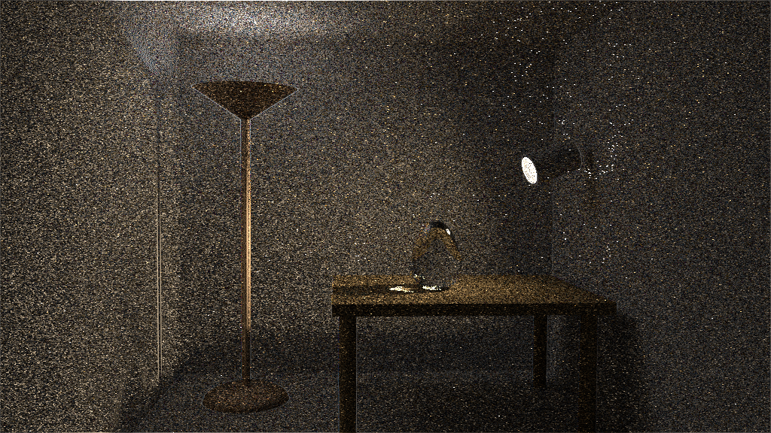

Gradient RENDERING INTEGRAL
$$G_{ij}=$$
Independent paths

Slide 26
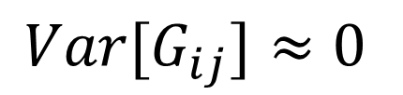

Gradient RENDERING INTEGRAL
$$≈0$$
$$G_{ij}≈\frac{1}{N}\sum_{k=1}^{N}{\frac{f_{i}\left(T\left(\overline{x_{k}}\right)\right)\left|\frac{dμ\left(T\left(\overline{x_{k}}\right)\right)}{dμ\left(\overline{x_{k}}\right)}\right|−f_{j}\left(\overline{x_{k}}\right)}{p(\overline{x_{k})}}}$$
Correlated base and offset paths
$${Var[G}_{ij}]≈0$$

Slide 27
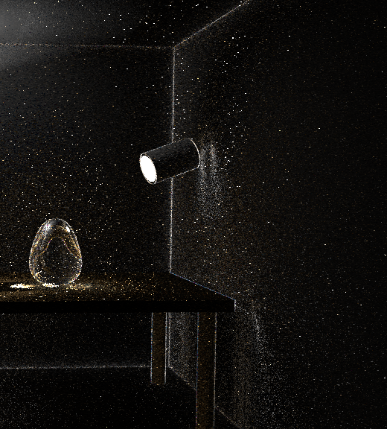
Gradient RENDERING INTEGRAL
$$G_{ij}=$$
Gradient at smooth regions are close to zero
Correlated paths using
shift mapping
Independent paths

Slide 28
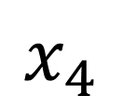
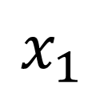
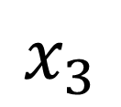
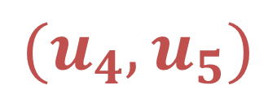
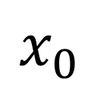
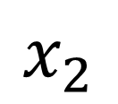
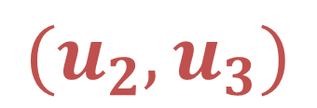
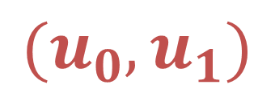
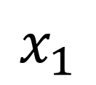
Random SEQUENCE replay
$$x_{3}$$
$$(u_{4},u_{5})$$
$$x_{4}$$
$$x_{1}$$
$$x_{0}$$
$$(u_{0},u_{1})$$
$$(u_{2},u_{3})$$
$$x_{2}$$
$$x_{1}$$

Slide 29

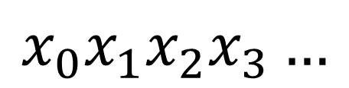
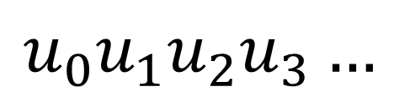
Random SEQUENCE replay
Pixel $j$
Primary Sample Space
Path space
$$u_{0}u_{1}u_{2}u_{3}…$$
$$x_{0}x_{1}x_{2}x_{3}…$$

Slide 30

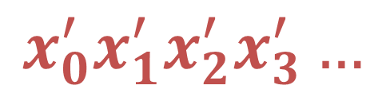
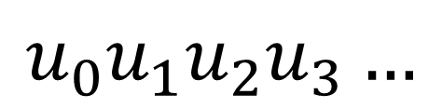
Random SEQUENCE replay
Similar [Kelemen and Szimay-Kalos 2002]
Pixel $i$
Primary Sample Space
Path space
$$u_{0}u_{1}u_{2}u_{3}…$$
$$x_{0}^{′}x_{1}^{′}x_{2}^{′}x_{3}^{′}…$$

Slide 31


Random SEQUENCE replay
$$p(\overline{x_{k}})/p(T\left(\overline{x_{k}}\right))$$
$$G_{ij}≈\frac{1}{N}\sum_{k=1}^{N}{\frac{f_{i}\left(T\left(\overline{x_{k}}\right)\right)\left|\frac{dμ\left(T\left(\overline{x_{k}}\right)\right)}{dμ\left(\overline{x_{k}}\right)}\right|−f_{j}\left(\overline{x_{k}}\right)}{p(\overline{x_{k})}}}$$

Slide 32
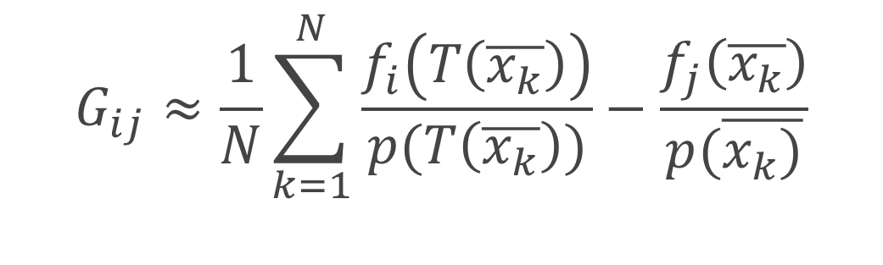
Random SEQUENCE replay
$$p(\overline{x_{k}})/p(T\left(\overline{x_{k}}\right))$$
$$G_{ij}≈\frac{1}{N}\sum_{k=1}^{N}{\frac{f_{i}\left(T\left(\overline{x_{k}}\right)\right)\left|\frac{dμ\left(T\left(\overline{x_{k}}\right)\right)}{dμ\left(\overline{x_{k}}\right)}\right|−f_{j}\left(\overline{x_{k}}\right)}{p(\overline{x_{k})}}}$$
Simplification:
$$G_{ij}≈\frac{1}{N}\sum_{k=1}^{N}{\frac{f_{i}\left(T\left(\overline{x_{k}}\right)\right)}{p(T\left(\overline{x_{k}}\right))}−\frac{f_{j}\left(\overline{x_{k}}\right)}{p(\overline{x_{k})}}}$$

Slide 33
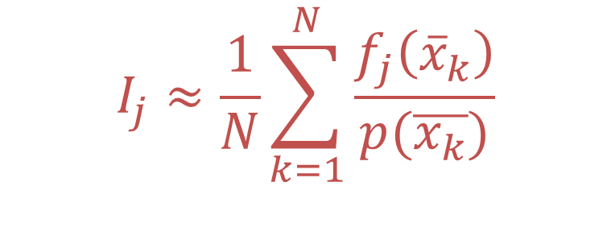
Random SEQUENCE replay
$$p(\overline{x_{k}})/p(T\left(\overline{x_{k}}\right))$$
$$G_{ij}≈\frac{1}{N}\sum_{k=1}^{N}{\frac{f_{i}\left(T\left(\overline{x_{k}}\right)\right)\left|\frac{dμ\left(T\left(\overline{x_{k}}\right)\right)}{dμ\left(\overline{x_{k}}\right)}\right|−f_{j}\left(\overline{x_{k}}\right)}{p(\overline{x_{k})}}}$$
Simplification:
$$G_{ij}≈\frac{1}{N}\sum_{k=1}^{N}{\frac{f_{i}\left(T\left(\overline{x_{k}}\right)\right)}{p(T\left(\overline{x_{k}}\right))}−\frac{f_{j}\left(\overline{x_{k}}\right)}{p(\overline{x_{k})}}}$$
$$I_{j}≈\frac{1}{N}\sum_{k=1}^{N}{\frac{f_{j}\left({\overline{x}}_{k}\right)}{p(\overline{x_{k}})}}$$
Path tracing

Slide 34
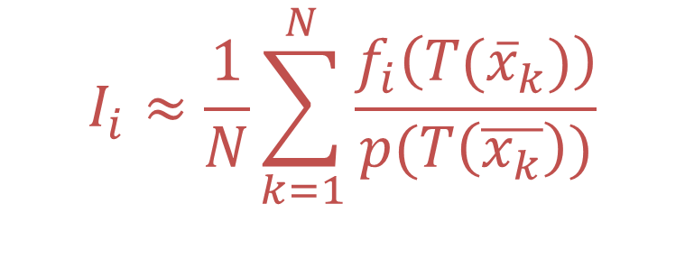
Random SEQUENCE replay
$$p(\overline{x_{k}})/p(T\left(\overline{x_{k}}\right))$$
$$G_{ij}≈\frac{1}{N}\sum_{k=1}^{N}{\frac{f_{i}\left(T\left(\overline{x_{k}}\right)\right)\left|\frac{dμ\left(T\left(\overline{x_{k}}\right)\right)}{dμ\left(\overline{x_{k}}\right)}\right|−f_{j}\left(\overline{x_{k}}\right)}{p(\overline{x_{k})}}}$$
Simplification:
$$G_{ij}≈\frac{1}{N}\sum_{k=1}^{N}{\frac{f_{i}\left(T\left(\overline{x_{k}}\right)\right)}{p(T\left(\overline{x_{k}}\right))}−\frac{f_{j}\left(\overline{x_{k}}\right)}{p(\overline{x_{k})}}}$$
$$I_{i}≈\frac{1}{N}\sum_{k=1}^{N}{\frac{f_{i}\left(T({\overline{x}}_{k})\right)}{p(T\left(\overline{x_{k}}\right))}}$$
Path tracing

Slide 35
THE BASIC ALGORITHM
1. Perform standard Monte Carlo rendering to obtain primal image
2. Sample gradients: horizontal and vertical
3. Reconstruct image from primal and gradients

Slide 36
THE BASIC ALGORITHM
1. Perform standard Monte Carlo rendering to obtain primal image
2. Sample gradients: horizontal and vertical
3. Reconstruct image from primal and gradients

Slide 37
Image reconstruction
Reconstructed image
Primal
Fusing gradients and primal information inside
one image
Gradients

Slide 38
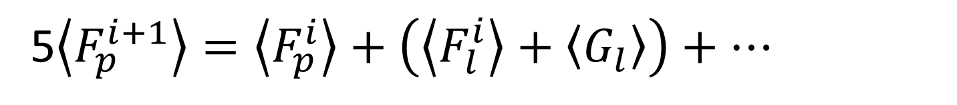
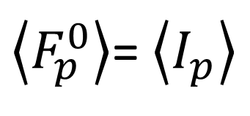

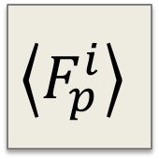
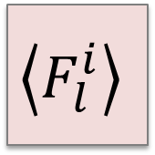
IMAGE RECONSTRUCTION
Image-space control variate [Rousselle et al., 2016]
Reformulate reconstruction as an iterative process:
$$\left\langle G_{l}\right\rangle$$
5$\left\langle F_{p}^{i+1}\right\rangle =\left\langle F_{p}^{i}\right\rangle +\left(\left\langle F_{l}^{i}\right\rangle +\left\langle G_{l}\right\rangle \right)+…$
$$\left\langle F_{l}^{i}\right\rangle$$
$$\left\langle F_{p}^{i}\right\rangle$$
Next iteration
value
Pixel value
Left pixel
Left gradient
$\left\langle F_{p}^{0}\right\rangle$= $\left\langle I_{p}\right\rangle$

Slide 39
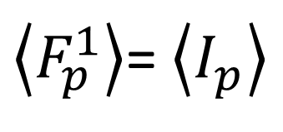

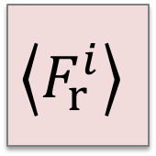
IMAGE RECONSTRUCTION
Image-space control variate [Rousselle et al., 2016]
Reformulate reconstruction as an iterative process:
$$\left\langle G_{r}\right\rangle$$
5$\left\langle F_{p}^{i+1}\right\rangle =\left\langle F_{p}^{i}\right\rangle +\left(\left\langle F_{l}^{i}\right\rangle +\left\langle G_{l}\right\rangle \right)+…$
$$\left\langle F_{p}^{i}\right\rangle$$
$$\left\langle F_{r}^{i}\right\rangle$$
Next iteration
value
Pixel value
Left pixel
Left gradient
$\left\langle F_{p}^{1}\right\rangle$= $\left\langle I_{p}\right\rangle$

Slide 40
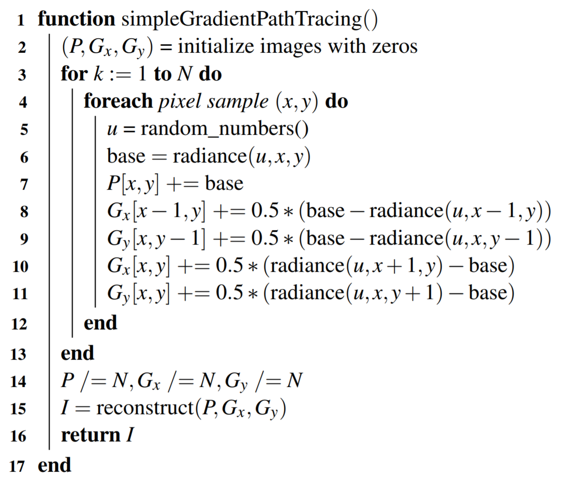
IMPLEMENTING A SIMPLE GRADIENT PATH TRACER

Slide 41
IMPLEMENTING A SIMPLE GRADIENT PATH TRACER
Primary Sample Space

Slide 42
IMPLEMENTING A SIMPLE GRADIENT PATH TRACER
Primary Sample Space

Slide 43
IMPLEMENTING A SIMPLE GRADIENT PATH TRACER
Primary Sample Space

Slide 44


IMPLEMENTING A SIMPLE GRADIENT PATH TRACER
Primary Sample Space
$$i$$
$$j$$

Slide 45


IMPLEMENTING A SIMPLE GRADIENT PATH TRACER
5$\left\langle F_{p}^{i+1}\right\rangle =\left\langle F_{p}^{i}\right\rangle +\left(\left\langle F_{l}^{i}\right\rangle +\left\langle G_{l}\right\rangle \right)+…$

Slide 46


Slide 47



Path Tracing
G-Path Tracing
0.0
Error
> 0.05

Slide 48
G-Path Tracing
0.0
Error
> 0.05

Slide 49

Better G-Path Tracing
0.0
Error
> 0.05

