Slide 1
A Survey on
Gradient-Domain Rendering
Binh-Son Hua Adrien Gruson
Victor Petitjean Matthias Zwicker Derek Nowrouzezahrai
Elmar Eisemann Toshiya Hachisuka

Slide 2
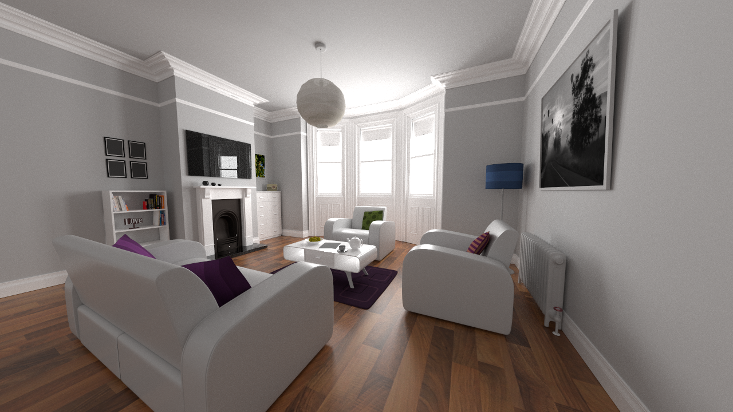
Reference (1 hour)

Slide 3
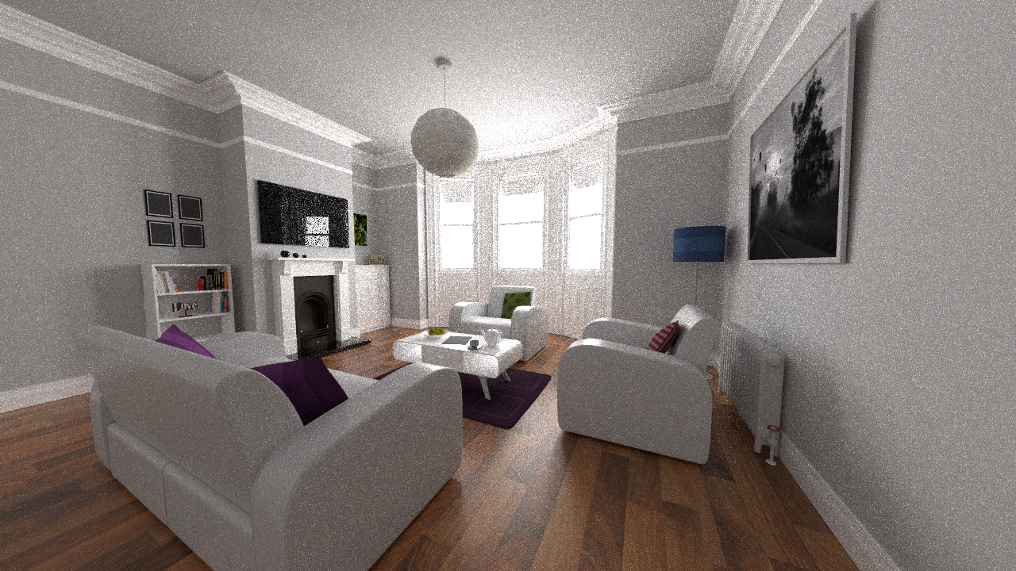
Path tracing (2 min)

Slide 4
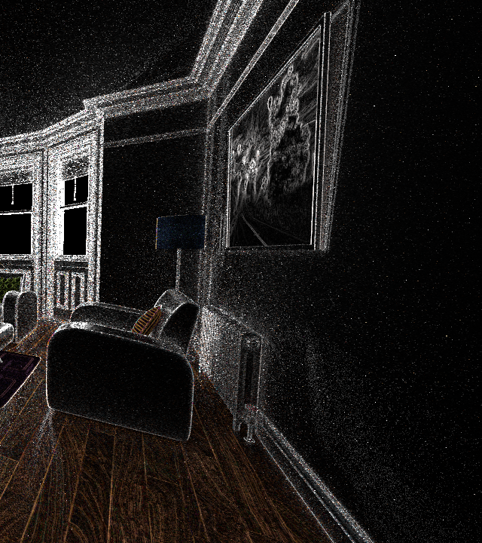
Primal
Gradient

Slide 5

Gradient-domain Path tracing (2 min)

Slide 6
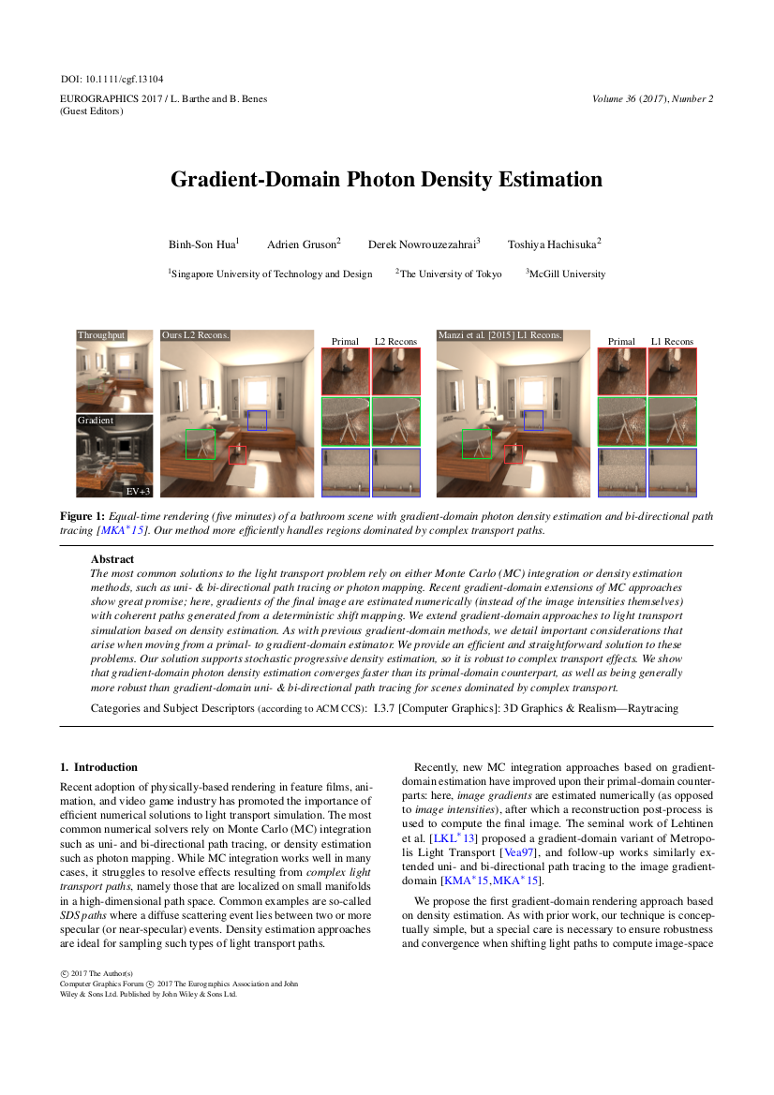
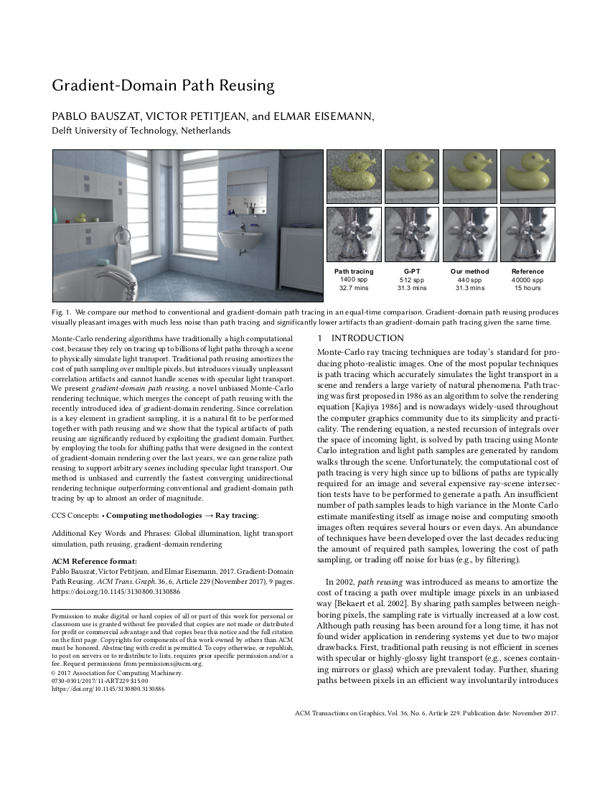
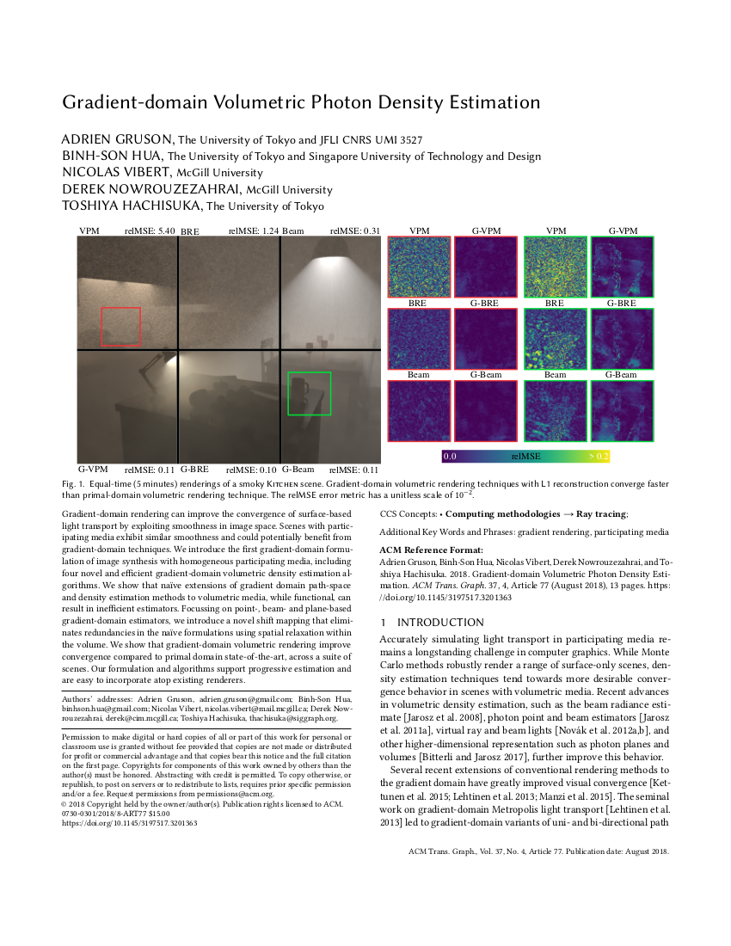
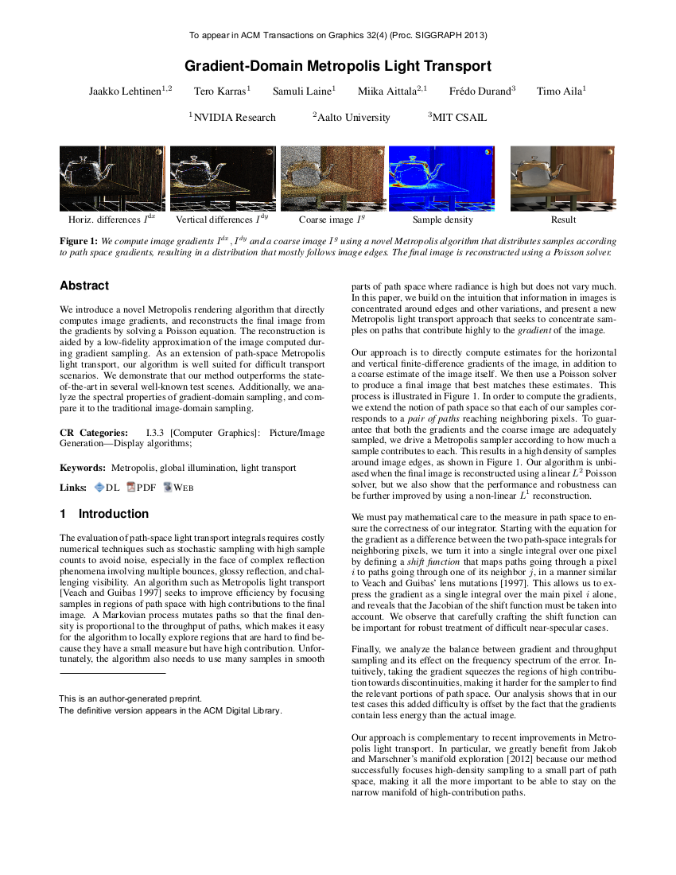
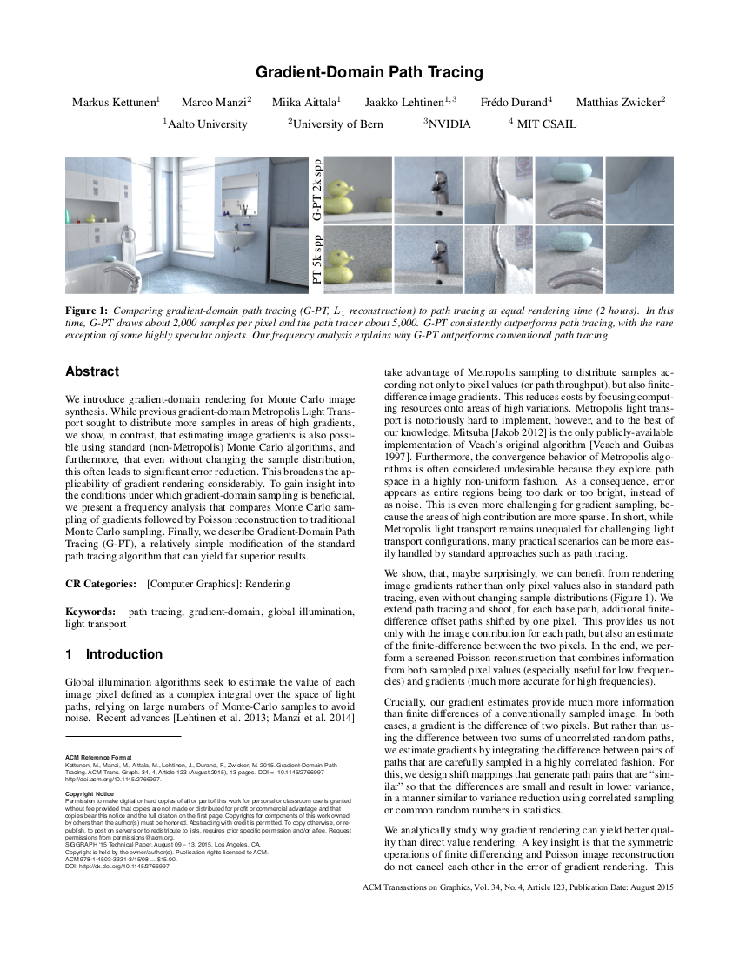
Gradient-Domain rendering
>15 papers on this subject

Slide 7
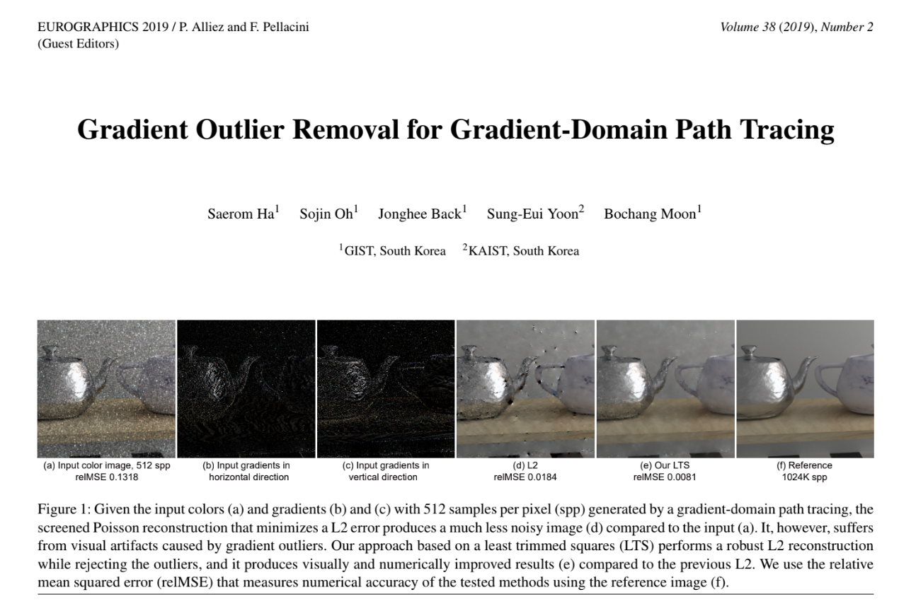
Gradient-Domain rendering
>15 papers on this subject

Slide 8
Syllabus
Fundamentals of gradient-domain light transport
Path tracing, shift mapping, simple gradient path tracing
[15 minutes]
Gradient-domain light transport algorithms
Advanced shift mapping and rendering techniques
[30 minutes]
Notes:
Here is the syllabus.

Slide 9
SYLLABUS
Image reconstruction
[15 minutes]
Advanced topics in gradient-domain rendering
Non-uniform kernels, Adaptive sampling, Higher dimensional integrals
[20 minutes]
Future research & Conclusion
[5 minutes]

Slide 10
REPORT WEBPAGE
All slides will be released after the talk
(i.e., no need to take photos of the slides)

